Slide 1
Some Prominent Jewish Freemasons In Victoria’s History
Prepared and Presented By
Wor. Brother Mark Anderson
Temple Lodge, No. 33
Duncan, B.C.
For the 150th Anniversary Commemoration of the Cornerstone Laying Ceremony of Temple Beth Emanu-el, Victoria, B.C.
1-2 June 2013

Slide 2
Victoria Lodge, No. 1085 constituted 28 August 1860
There were 10 Charter Members. Two were Jewish.
James Johnson Southgate, Merchant.
George Pearkes, Solicitor.
James N. Thain, Merchant.
Amor de Cosmos, Editor.
Kady Gambitz, Draper.
Thomas Harris, Gentleman.
Lumley Franklin, Broker.
John T. Howard, Publican.
William Henry Thain, Carrier.
H. J. McDonell (vocation not given).

Slide 3
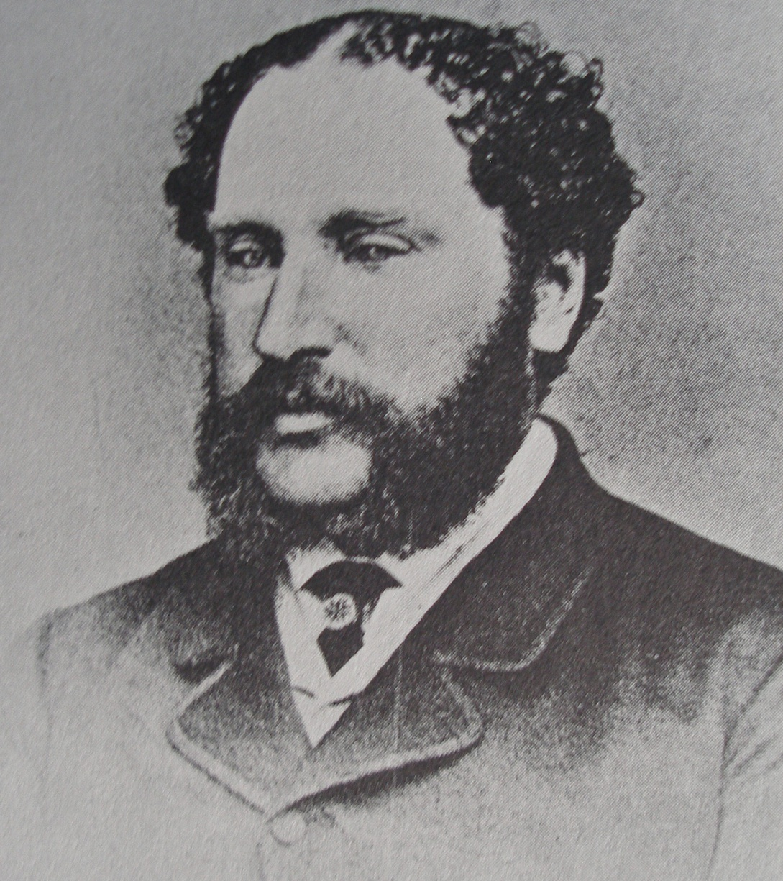
Lumley Franklin
(1820 – 1873)
Born Liverpool, England, circa 1820. His father, Lewis Franklin, was a banker in Liverpool.
In business with his brother, Selim Franklin, in San Francisco in 1857.
Joined Selim Franklin in Victoria in 1858 in the firm S. Franklin & Co.
- One of ten Charter Members of Victoria Lodge, No. 1085, the first Masonic Lodge in Victoria, constituted 28 August 1860.
- Originally a member of Occidental Lodge, No. 22 in San Francisco
- Went into business for himself in Victoria as an auctioneer, real estate agent and merchant.
- Victoria’s second Mayor, 1865 . Urged to seek a second term but declined. Served on School Board in 1867 with Dr. Israel Wood Powell, another prominent Freemason.

Slide 4
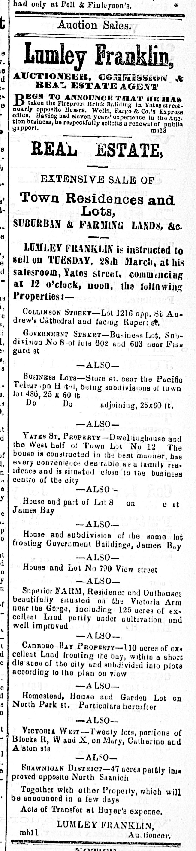
Lumley Franklin
(1820 – 1873)
Advertisement from the British Colonist, March 1871 shows Lumley Franklin as an “Auctioneer, Commission & Real Estate Agent” with a business premises in what is now the 500 block of Yates Street..
Among his real estate listings in this advertisement:
110 acres fronting Cadboro Bay;
125 acres of farmland on Victoria Arm, near the Gorge;
- House and subdivision fronting Government Buildings in James Bay;
- 20 lots on Catherine, Mary and Alston Streets in Vic West;
- Homestead, house and garden lot on North Park St.;
- 47 acres in Shawnigan District.

Slide 5
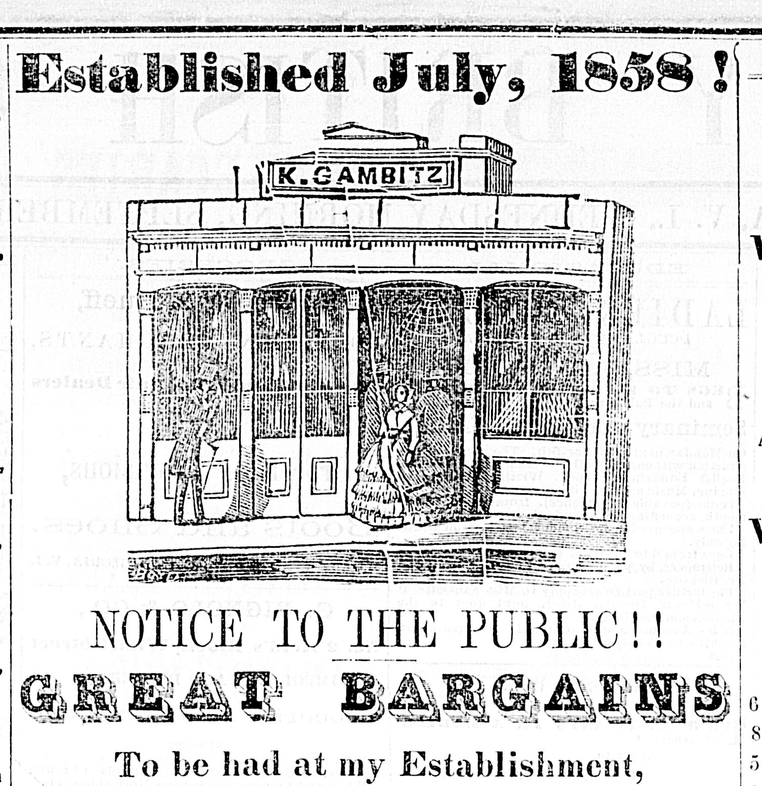
Kady Gambitz
Worshipful Master of Victoria Lodge, No. 1085 (now Victoria-Columbia Lodge, No. 1) in 1866
- Charter member of Victoria Lodge, No. 1085 in 1860.
-Established a dry goods business on Government Street in 1858. The business moved to Yates Street a few years later.
-- The first meeting of Victoria’s Jewish community occurred in the drygoods store of Kady Gambitz in August of 1858 in order to plan observances of the Jewish New Year and Day of Atonement.
-This image of Kady Gambitz’s store on Yates street is from an 1863 advertisement.

Slide 6
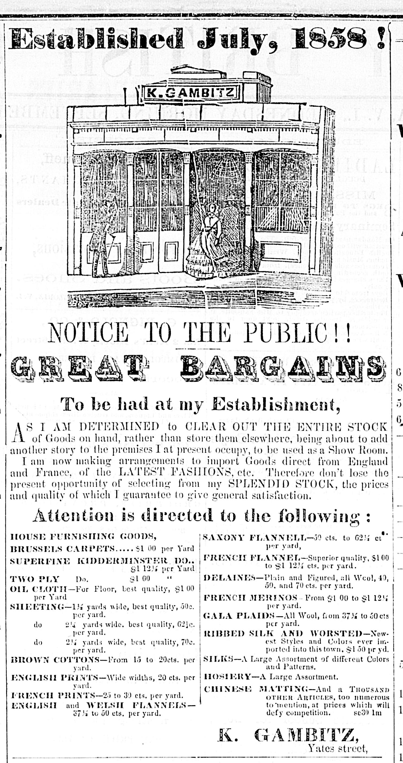
Kady Gambitz
One of the leading members of Congregation Beth Emanu-el. Played a leading role in organizing the building of Temple Beth Emanu-el in 1863.
- Left Victoria about 1870 and returned to California.
- The advertisement at right is from 1863.

Slide 7
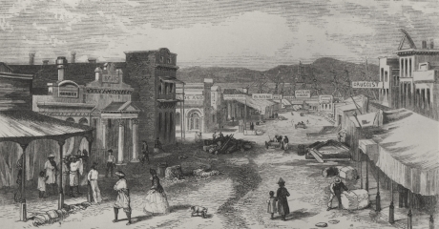
Yates Street – 500 block circa 1862
Kady Gambitz dry goods store is second building from left. It opened in 1859.
(Between Adelphi Saloon and Bank of British North America)
Hibben & Carswell Stationers, the site of Victoria’s first Masonic Temple, is 5th from left

Slide 8
Other Jewish Freemasons
At The Temple Beth Emanu-el Cornerstone Ceremony on 2 June 1863
Moses Sporburg
Prominent Member of Congregation Beth Emanu-el. Member of Victoria Lodge, No. 1085 (now Victoria-Columbia Lodge, No. 1); also a Past Grand in the Independent Order of Odd Fellows.
John Malowanski
The first man to be made a Mason in Victoria following the creation of Victoria Lodge, No. 1085.
Morris Myer

Slide 9
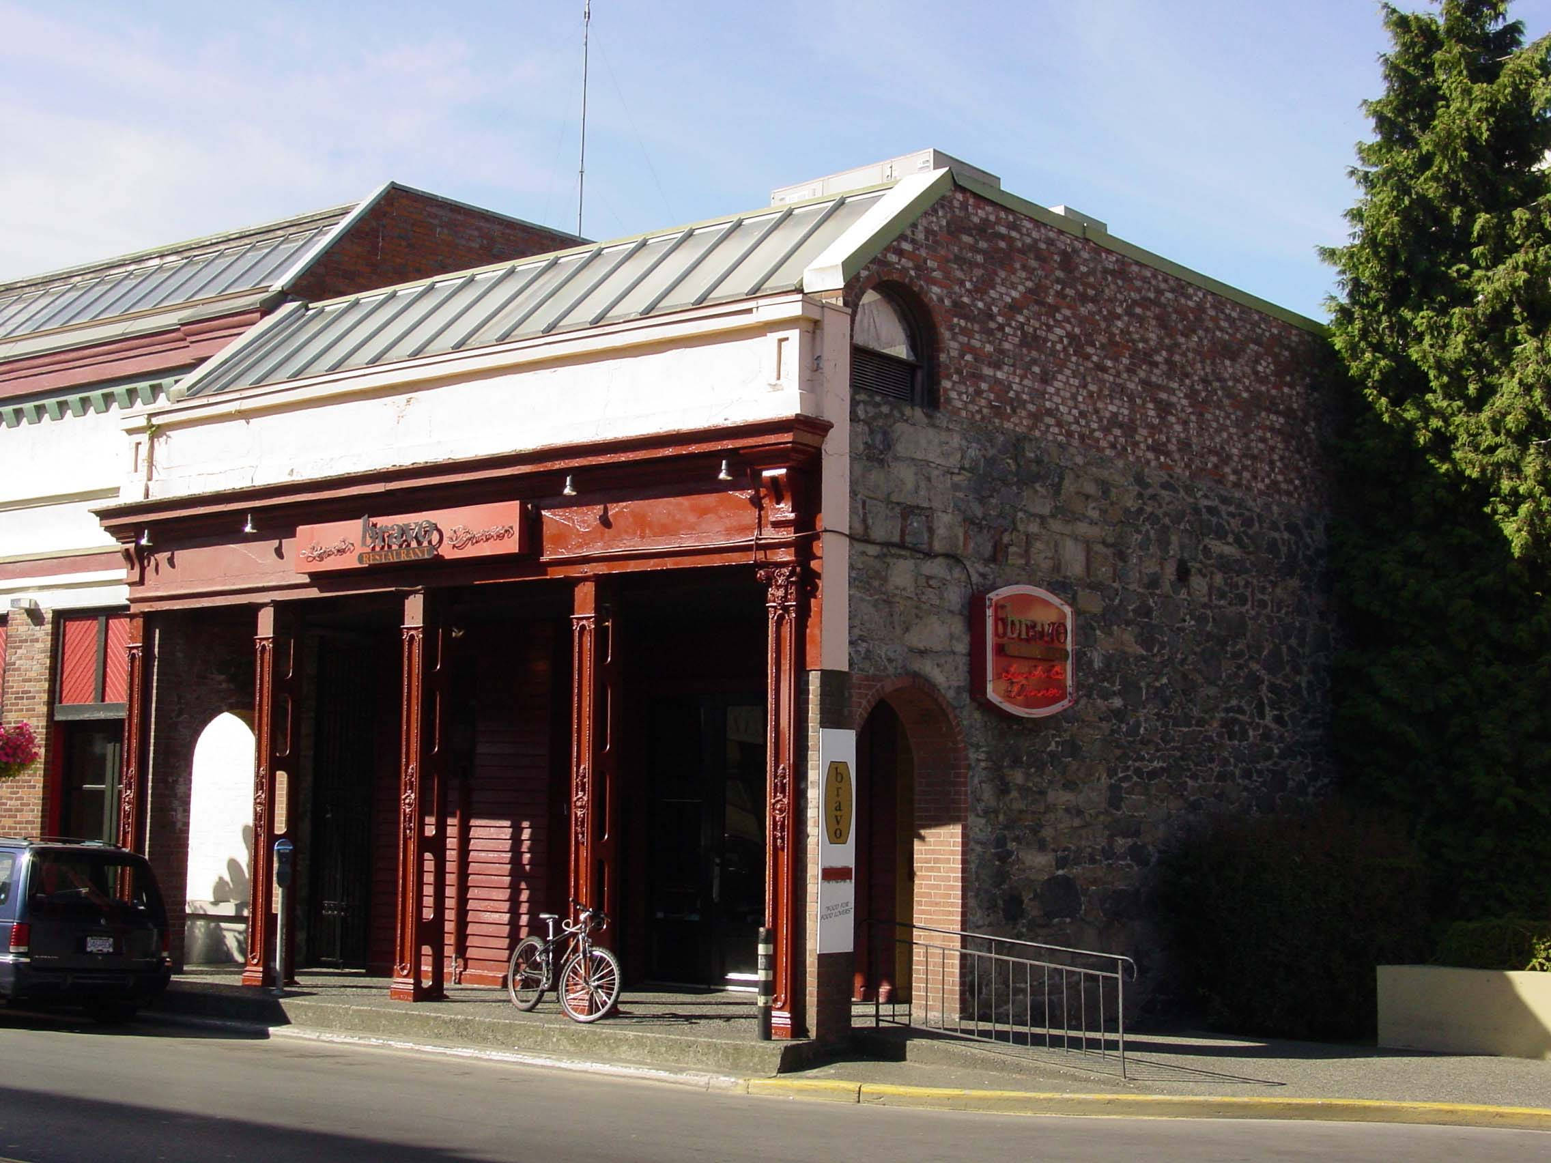
Judah Philip Davies
(died September 1879, aged 58)
Born in London, U.K.
Went to San Francisco in 1849. Was in business in Monterrey and Sacramento, California;
Came to Victoria in 1863;
- established a successful auctioneers’ business, J.P. Davies & Co.;
The building at right was his business premises.
- member of Vancouver & Quadra Lodge, No. 2 in Victoria.
Delivered keynote address at the cornerstone ceremony of Temple Beth Emanu-el on 2 June 1863.

Slide 10
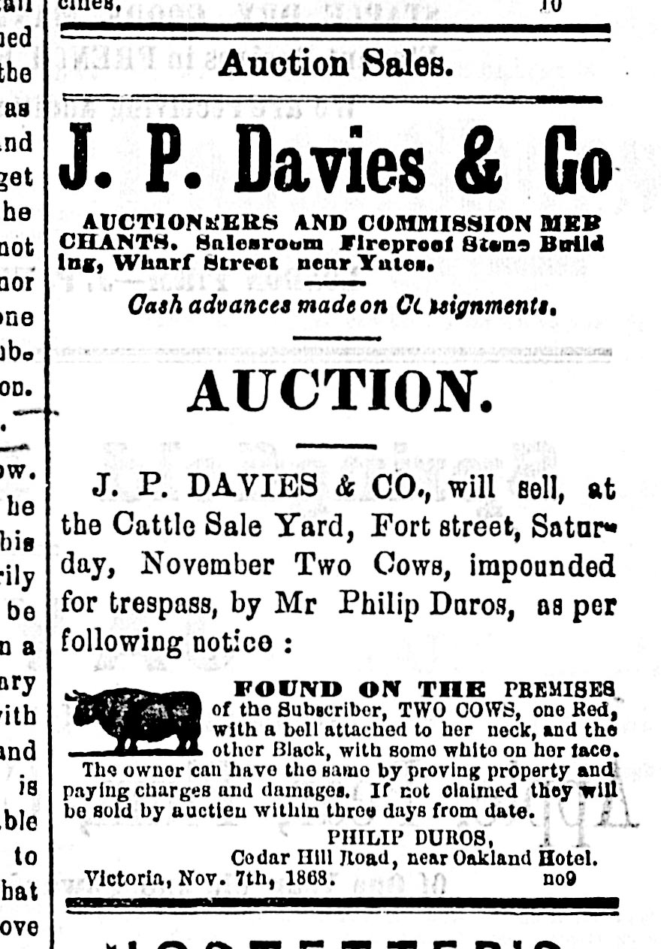
Judah Philip Davies
(died September 1879, aged 58)
Advertisement for J.P. Davies & Co., in British Colonist, 14 November 1868.
- His business is described as “Auctioneers and Commission Merchant”
His business premises is described as “Fireproof Stone Building, Wharf Street near Yates.” This is likely the building now at 1218 Wharf Street,

Slide 11
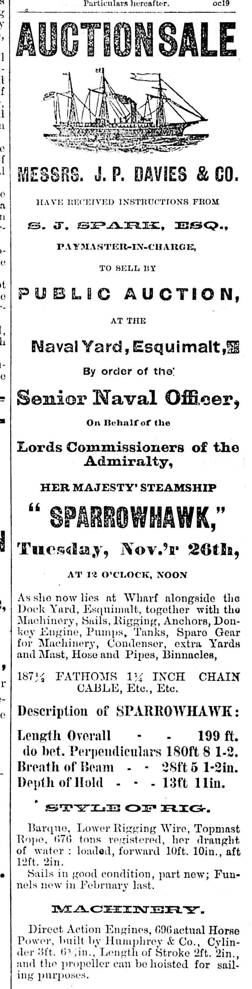
Judah Philip Davies
(died September 1879, aged 58)
1872 Advertisement For Auction Sale of a Royal Navy ship, H.M.S. Sparrowhawk, at Esquimalt Naval Yard.
Judah Philip Davies was the Royal Navy’s designated auctioneer for the Esquimalt base and the B.C. Coast. Upon his death, his son Joshua Davies assumed that position.

Slide 12
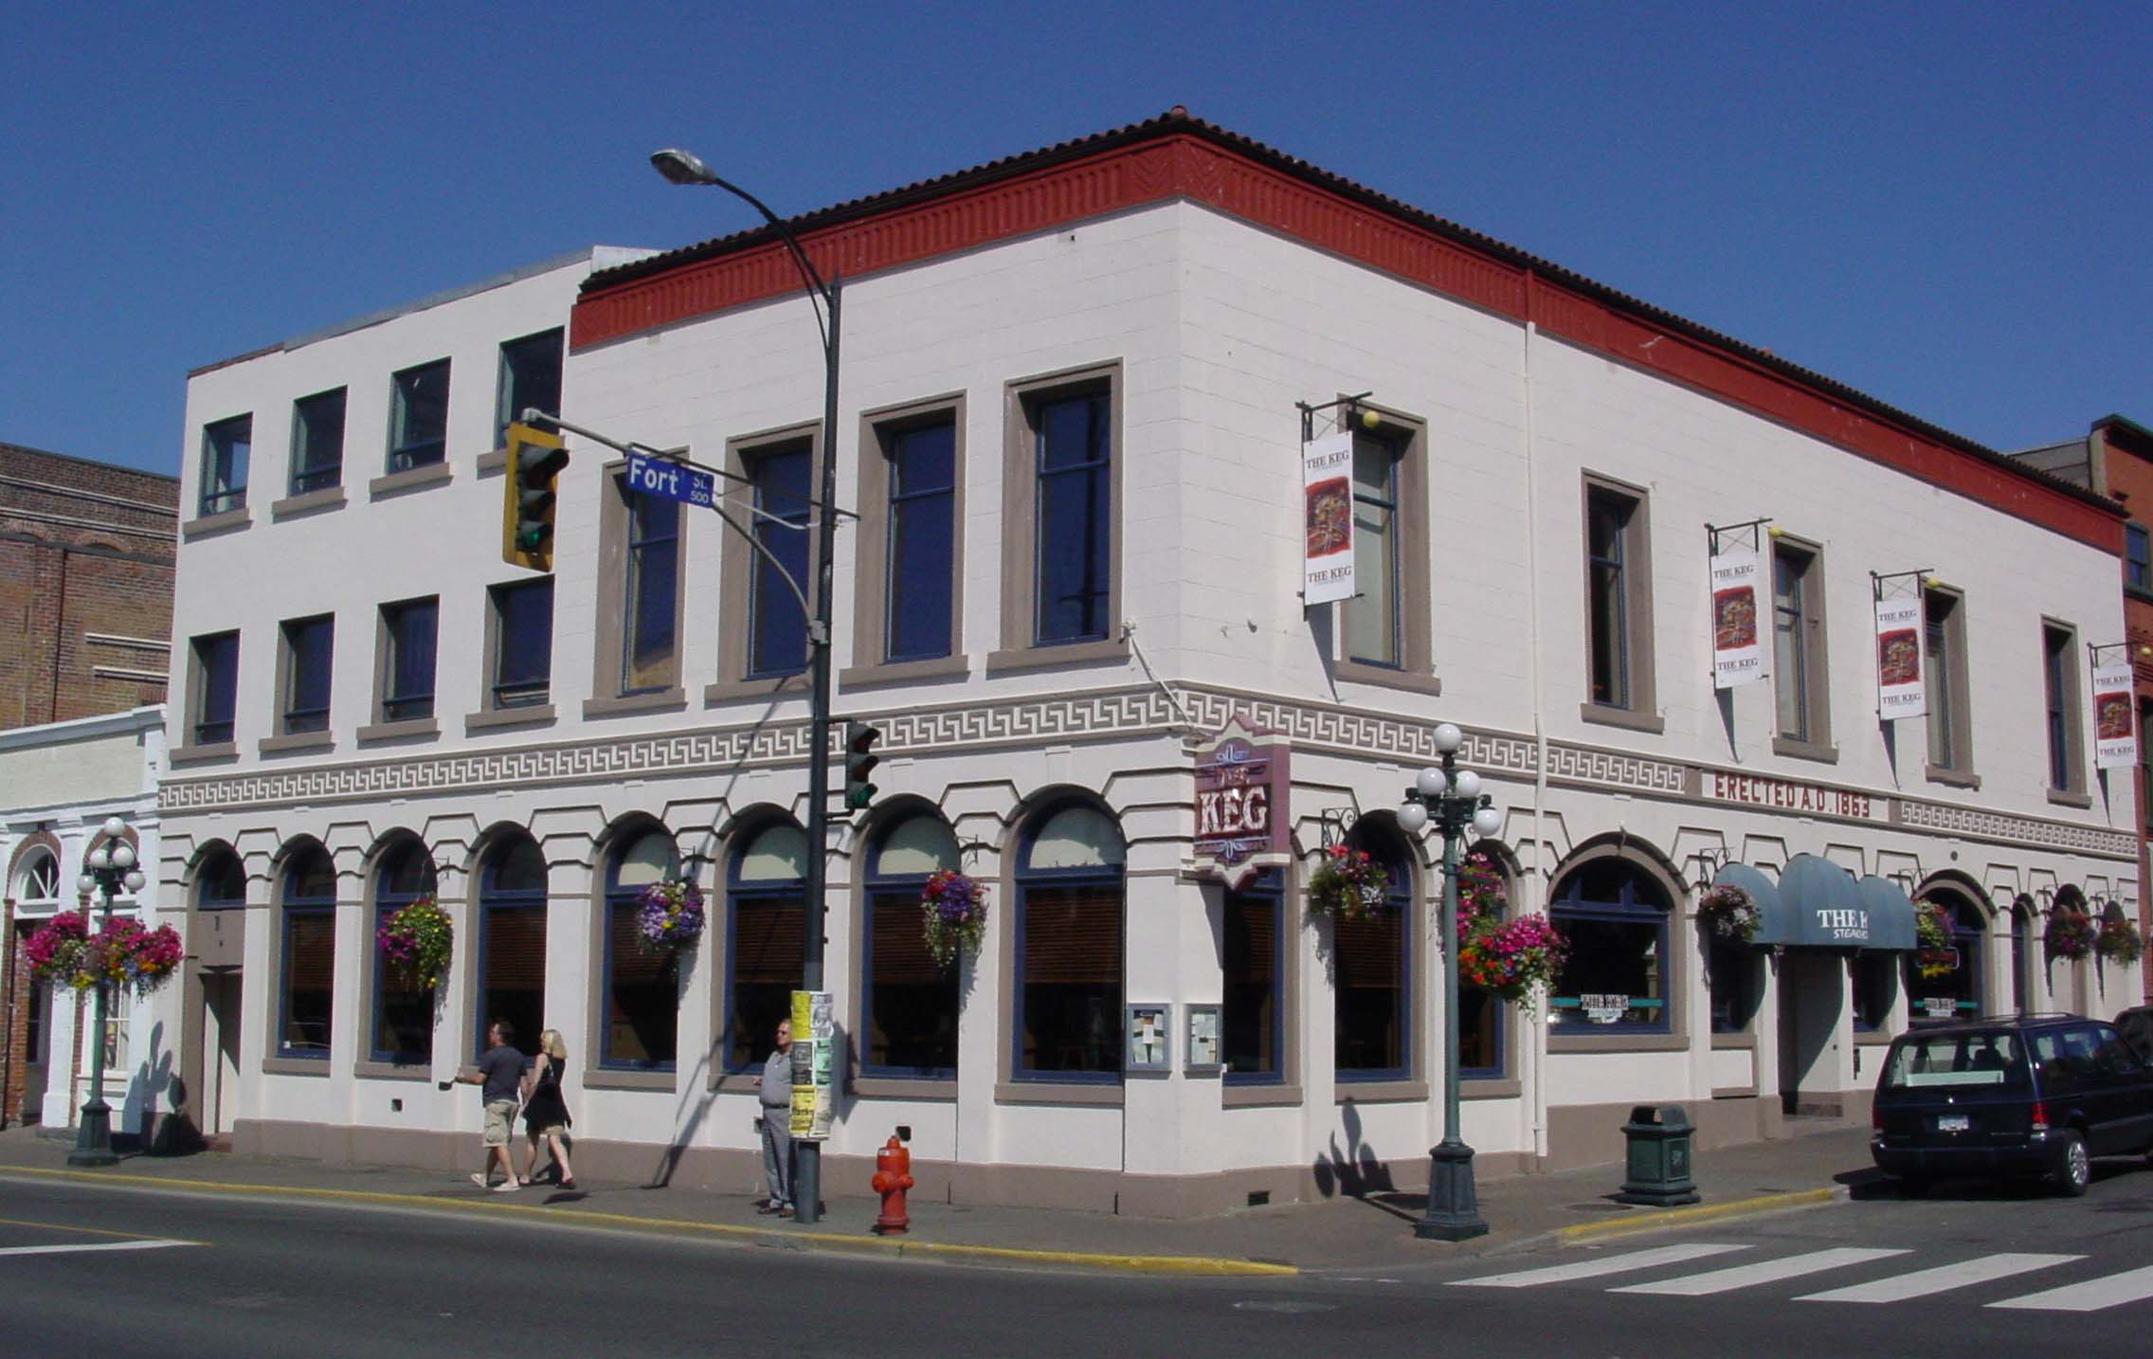
Judah Philllip Davies was also a leading member of the I.O.O.F.
This building at Fort and Wharf Streets contained the I.O.O.F. meeting rooms on the second floor between 1865 and 1879. It was designed by a Freemason, Richard Lewis.

Slide 13
J.P. Davies & Co. maintained its business premises in this stone building at 1218 Wharf St.

Slide 14
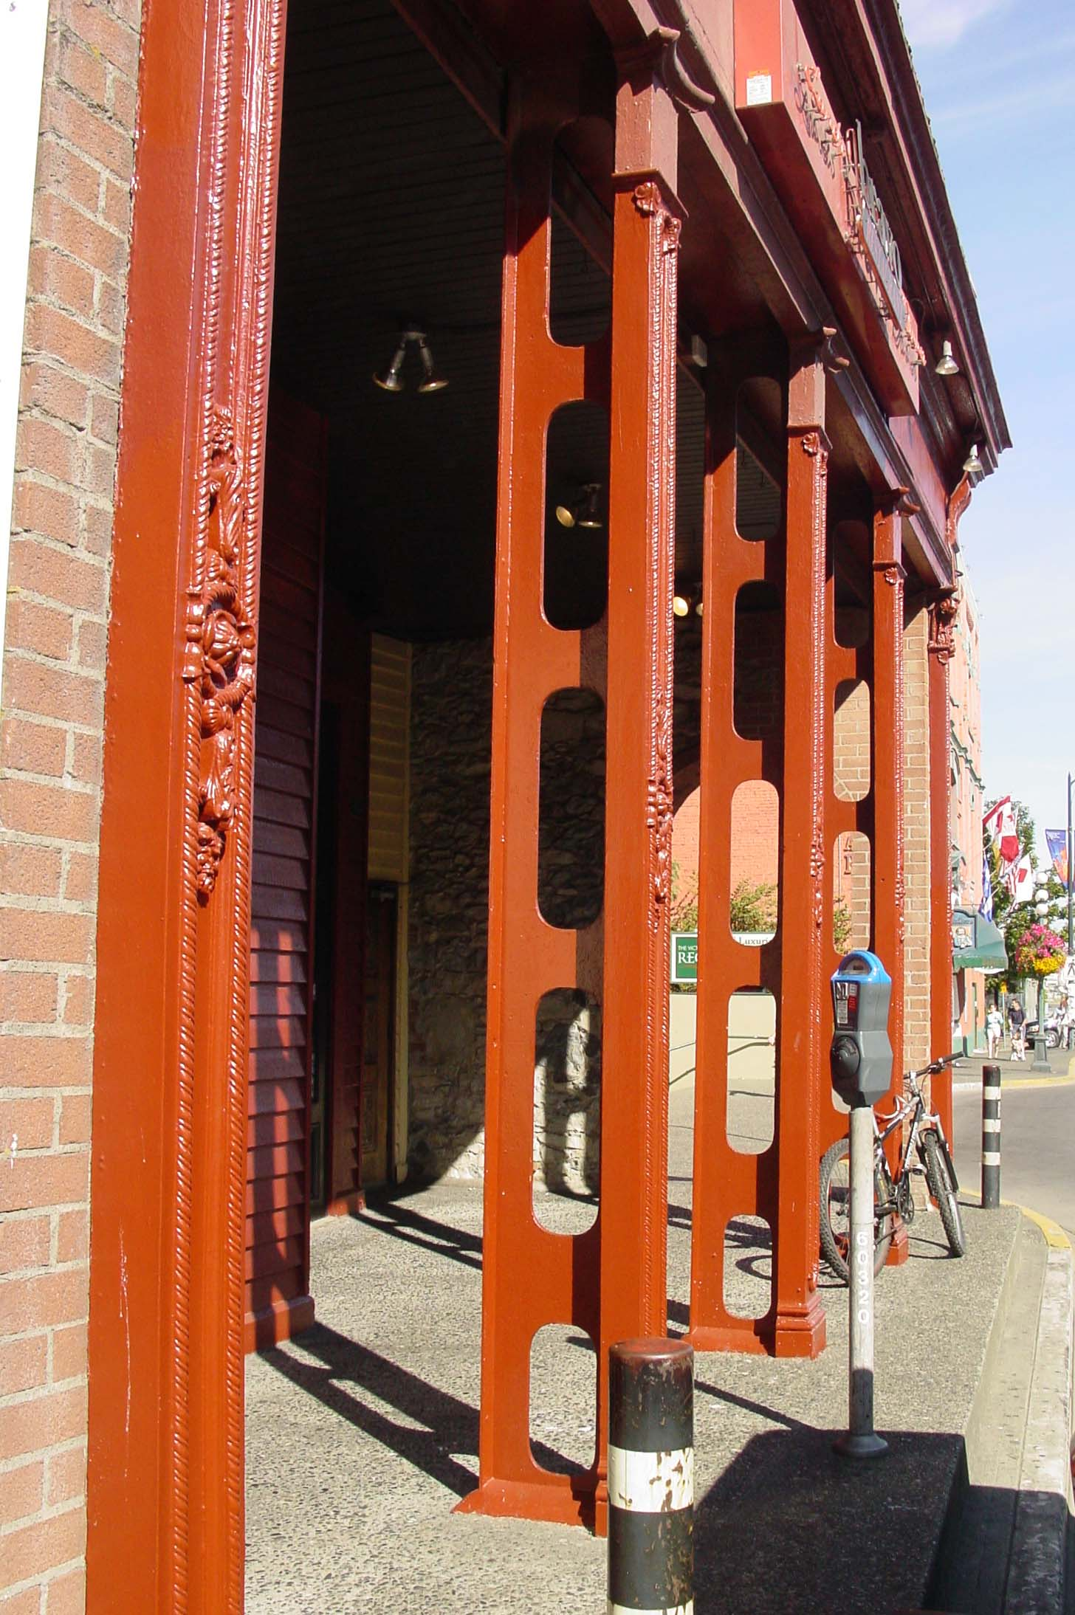
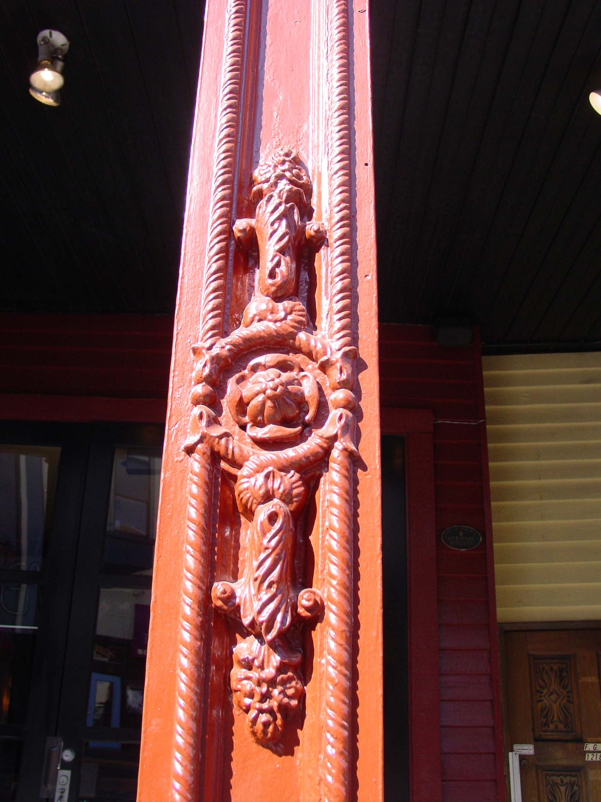
These iron support beams are interesting original architectural features of 1218 Wharf Street, formerly the business premises of J.P. Davies & Co.

Slide 15
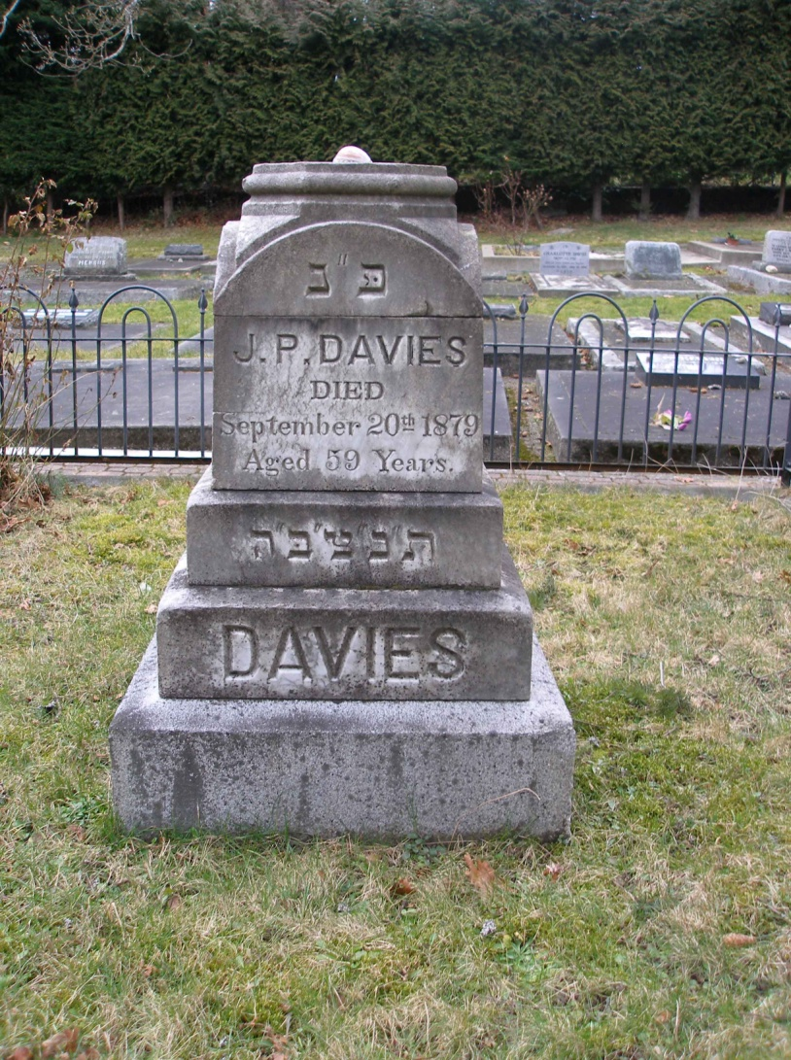
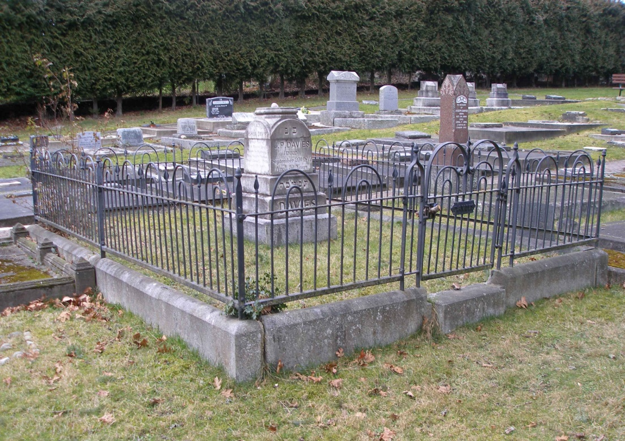
Judah Philip Davies family grave site
Victoria Jewish Cemetery
A January 1881 newspaper report indicates a 15 foot marble column, carved from Beaver Cove marble by Mortimer & Reed, was placed on the granite base of this tomb. No sign of it remains.

Slide 16
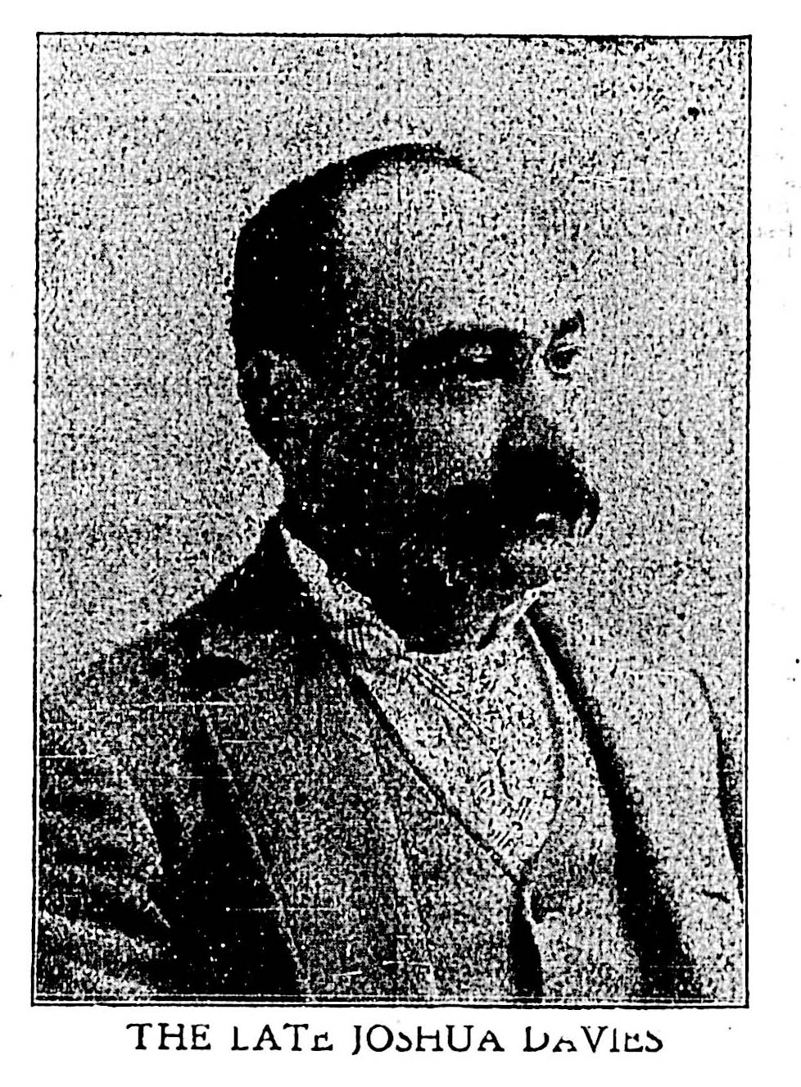
Joshua Phillip Davies
(1846 – 1903)
His name appears in the Vancouver & Quadra Lodge, No. 2 membership book as the 21st member of the Lodge.
His occupation is listed as “auctioneer” but unfortunately no further details appear in the V&Q membership book
He was also a member of the Independent Order of Oddfellows, serving as Grand Master of the I.O.O.F. In 1887-1888.
One of the leading auctioneers in the Province. He auctioned the first lots to be sold on the City of Vancouver townsite.

Slide 17
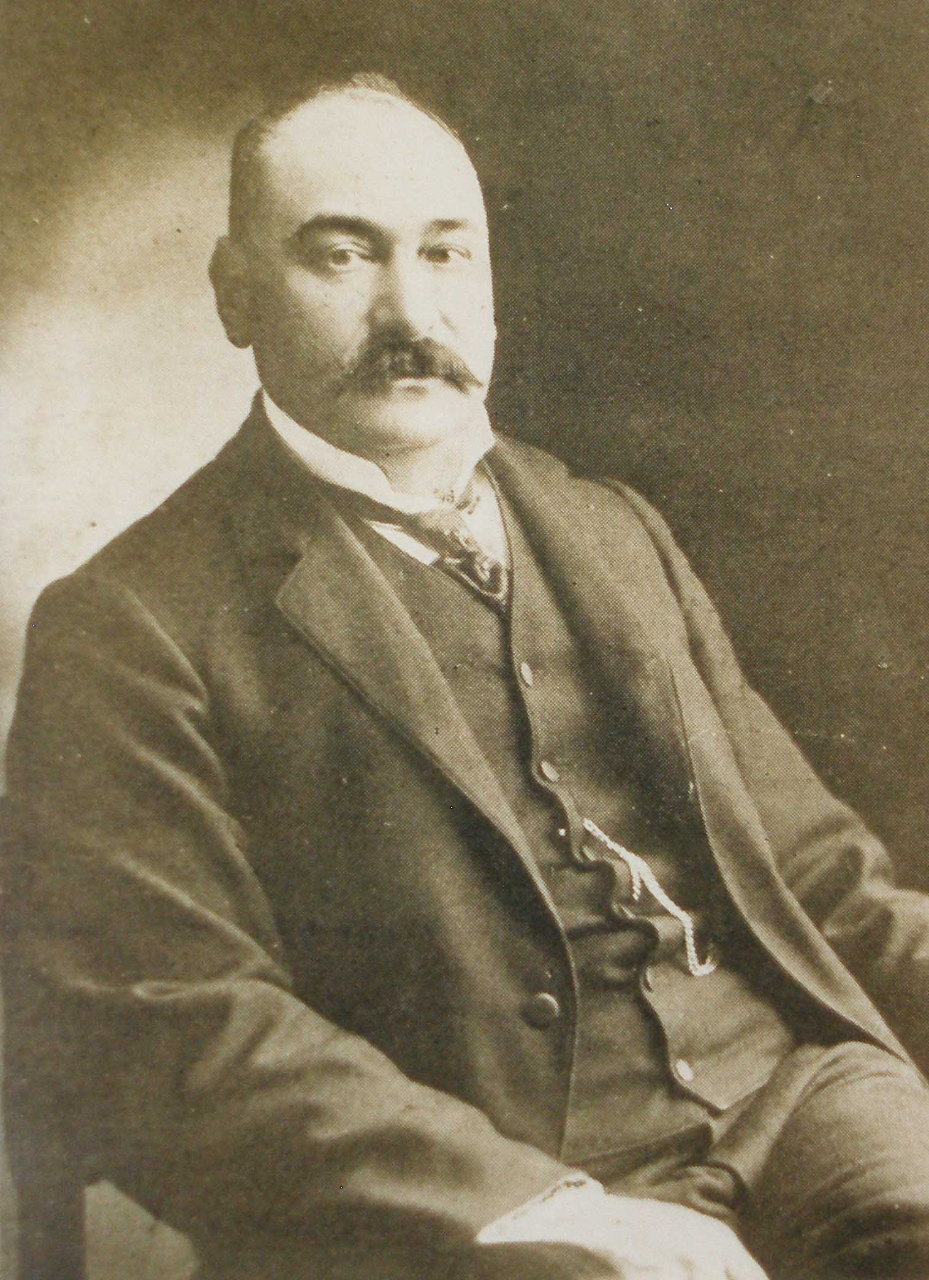
Joshua Phillip Davies
(1846 – 1903)
One of the leading figures in the formation of the Royal Jubilee Hospital. (Simon Leiser was another prominent contributor to the Jubilee Hospital)
Served on the Jubilee Hospital Board, including two terms as President.
Served on the Victoria Board of Trade.
Prominent in the I.O.O.F., serving two terms as Grand Master. He was instrumental in building the current I.O.O.F. Hall on Douglas Street.
One of the pioneer investors and developers in the Kootenay region of B.C.

Slide 18
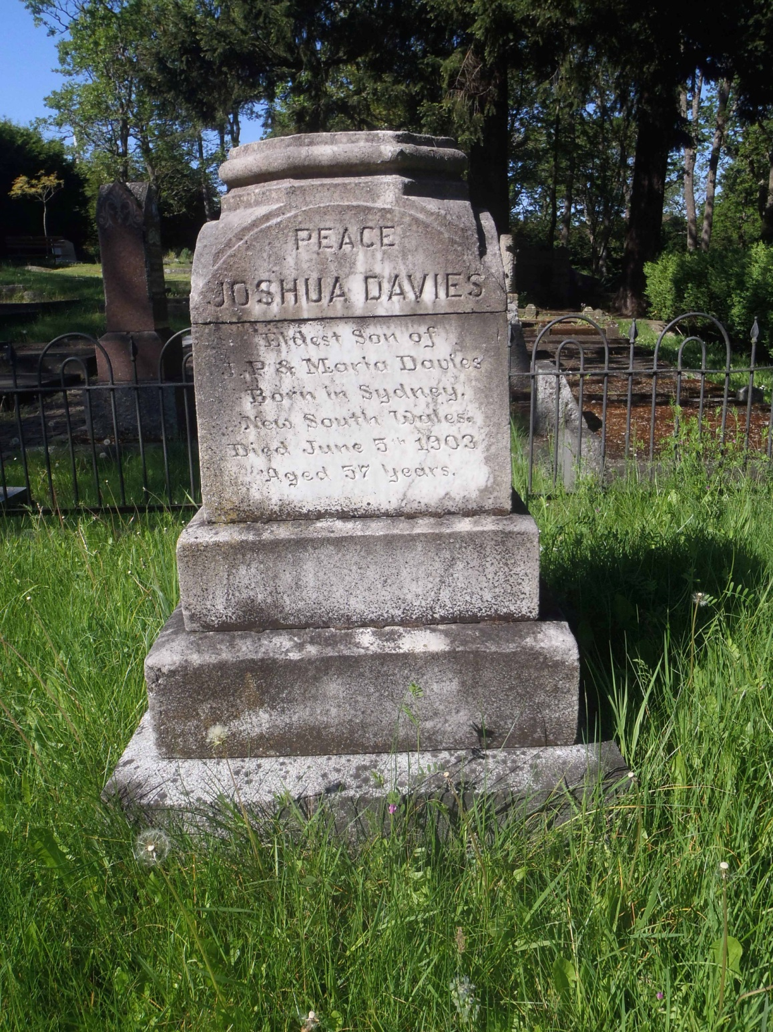
Joshua Philip Davies
(1846 – 1903)
The marker for Joshua Philip Davies in the Davies family plot in Victoria Jewish Cemetery.

Slide 19
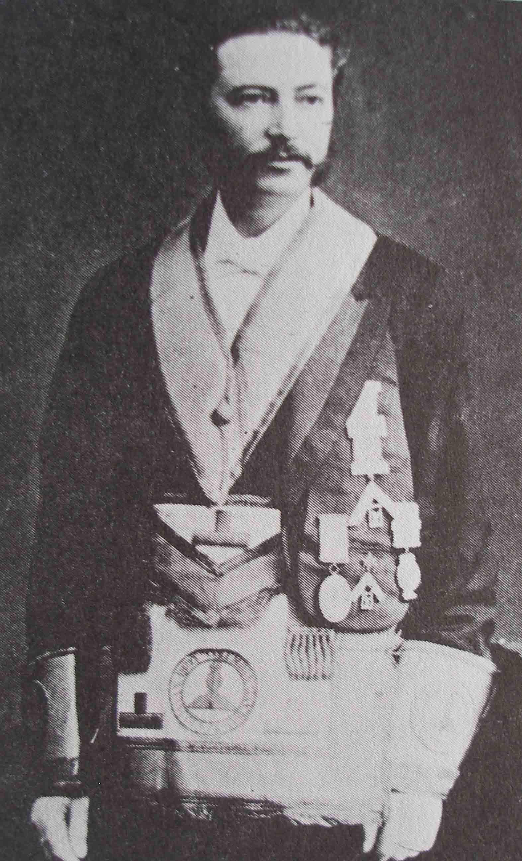
Henry Nathan, Jr.
(1842 – 1914)
Born London, England on 3 September 1842. Died in London, England on 25 February 1914
First Junior Grand Warden of Grand Lodge of B.C. In 1871
Member of Parliament for Victoria 1871 – 1874
- First member of Parliament for Victoria following B.C.’s entry into Confederation in 1871
- Elected to Parliament as a Liberal
- Member of Congregation Beth Emanu-el

Slide 20
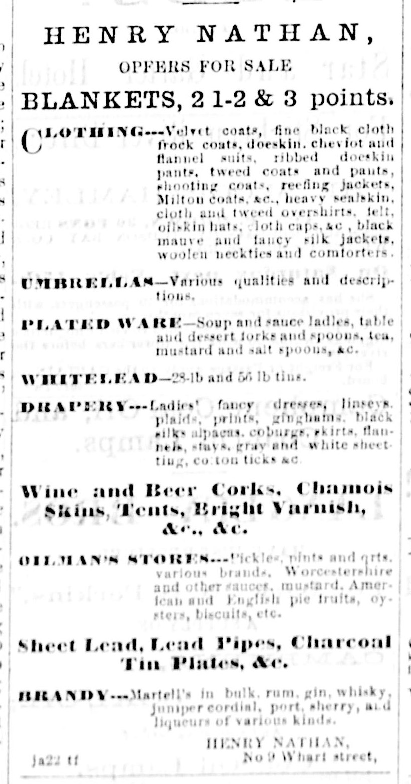
Henry Nathan, Jr.
(1842 – 1914)
Advertisement for Henry Nathan in British Colonist, February 1862.
He appears to have been what was known at the time as a commission merchant, or a wholesaler.
His business premises, shown as No. 9 Wharf Street, would have been on the east side of Wharf Street near Courtenay Street. This building no longer exists.

Slide 21
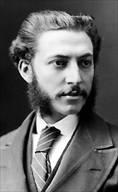
Henry Nathan, Jr.
(1842 – 1914)
Photo at right is from Libraries and Archives Canada. Photographer was William James Topley (1845-1930).
William Topley was a prominent Ottawa photographer who is noted for his many portraits of Canadian politicians. His collected works are kept in Canada’s Nation Archives.
Since William Topley was based in Ottawa, this photograph of Brother Henry Nathan, Jr. likely dates from his time as a Member of Parliament for Victoria between 1871 to 1874.
Henry Nathan returned to England in 1878 and died there in 1914.

Slide 22
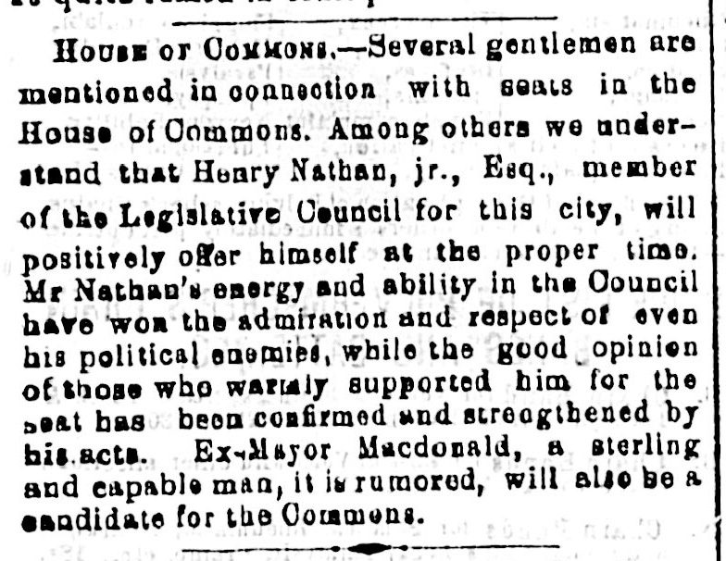
British Colonist endorsement of
Henry Nathan, Jr.
Candidacy For Member of Parliament, February 1871

Slide 23
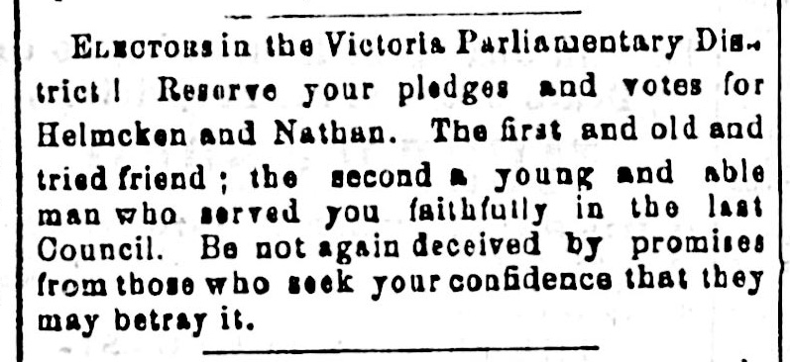
Parliamentary Election Advertisement for
Dr. John S. Helmcken and Harry Nathan, Jr.
British Colonist, August 1871

Slide 24
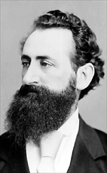
Henry Nathan Jr. and
Amor De Cosmos
Henry Nathan Jr. was elected as one of Victoria’s two M.P.’s in 1871.
The other was Amor de Cosmos (1825 – 1897), founder of the Daily British Colonist,
Amor de Cosmos was also a Freemason; a charter member of Victoria Lodge, No. 1085 in 1858.
Of the 10 charter members of Victoria Lodge, No 1085, two were Jewish: Lumley Franklin and Kady Gambitz
de Cosmos was very active in politics, serving as M.P. For Victoria (1871 – 1882), Premier of B.C. ( December 1872 – February 1874)
- The photo of de Cosmos at right was taken circa 1872 by Ottawa photographer William Topley.

Slide 25
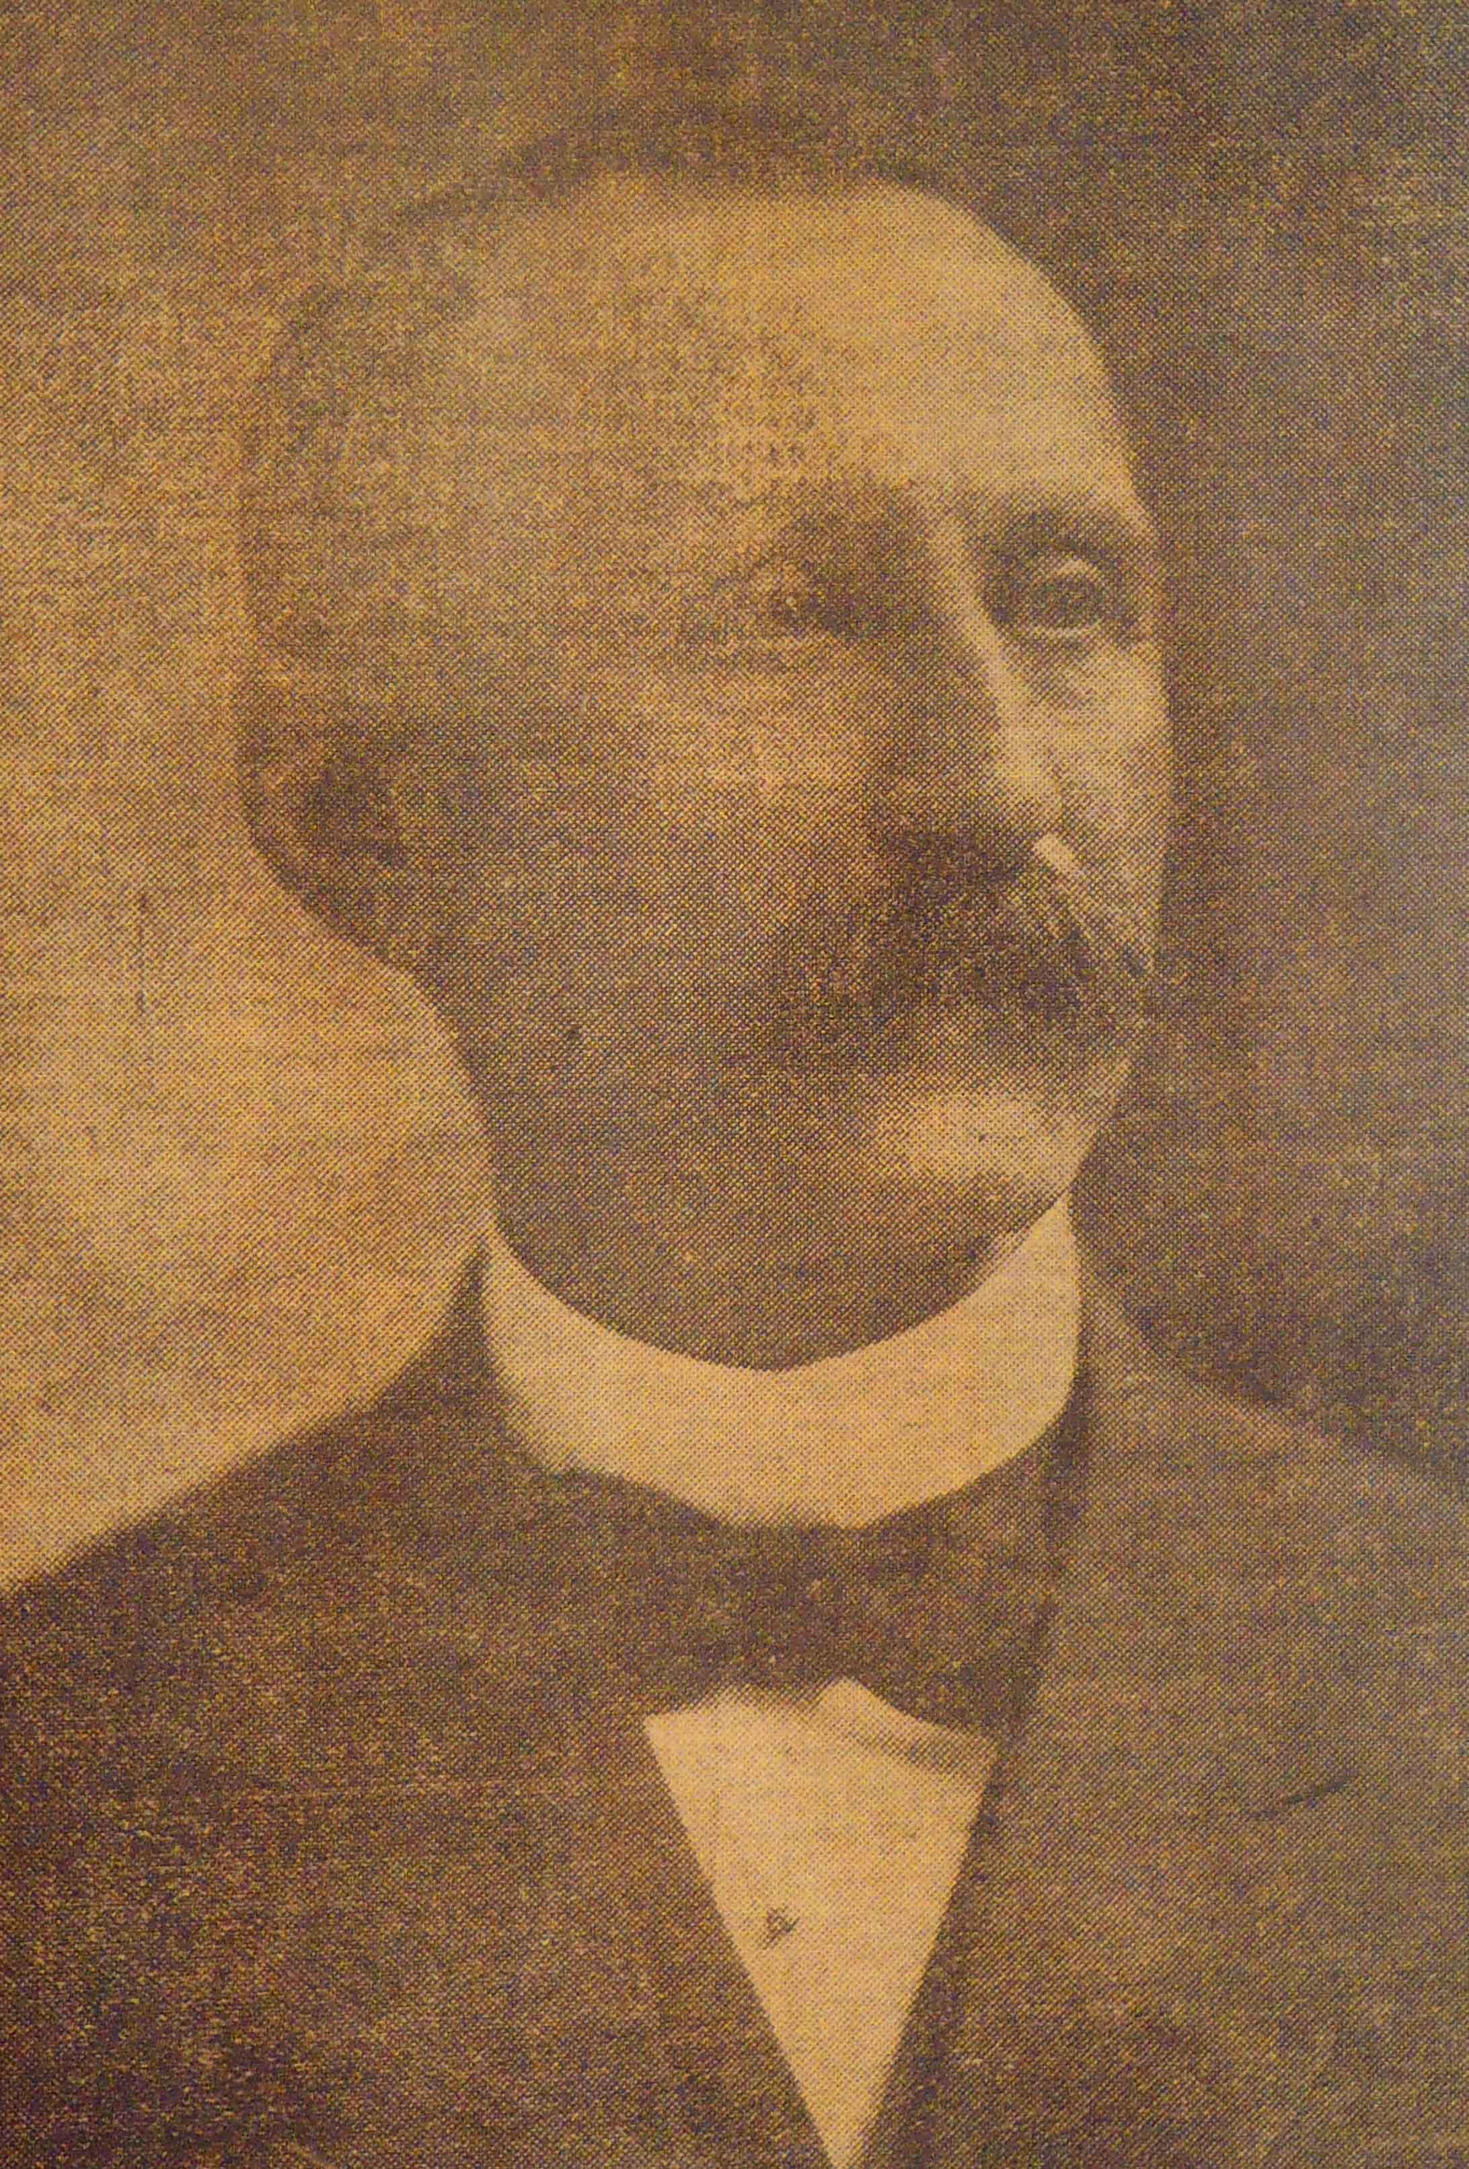
Simon Leiser
(9 April 1851 – 12 May 1917)
One of the leading businessmen in late 19th and early 20th century Victoria.
- Applied for Initiation in Vancouver & Quadra Lodge, No. 2 in 1879, stating his age as 27 and his occupation as “merchant”.
- Initiated in Vancouver & Quadra Lodge, No. 2 on 1 October 1879; Passed on 15 October 1879; Raised on
21 April 1880.

Slide 26
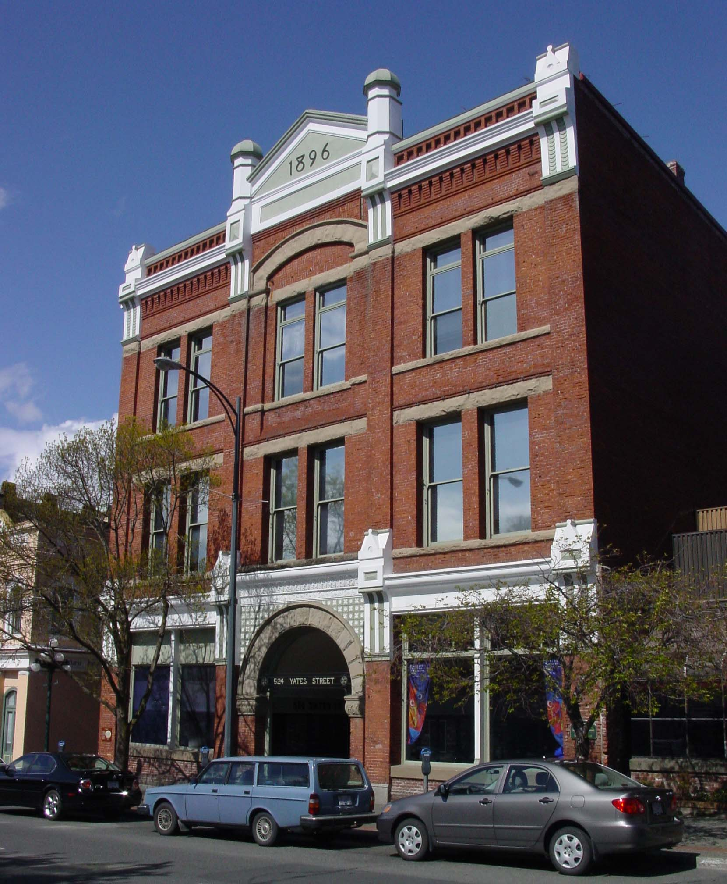
The Leiser Building
522-524 Yates Street
Designed for Simon Leiser in 1896 by architect A.C. Ewart.
Used as the head office and warehouse for Simon Leiser & Co., wholesale grocers.
The building originally had a central freight elevator with rail tracks leading from the elevator on each floor to allow efficient movement of goods.
After Simon Leiser’s death, the business was sold to Kelly, Douglas & Co.
The building was recently converted to condominiums.

Slide 27
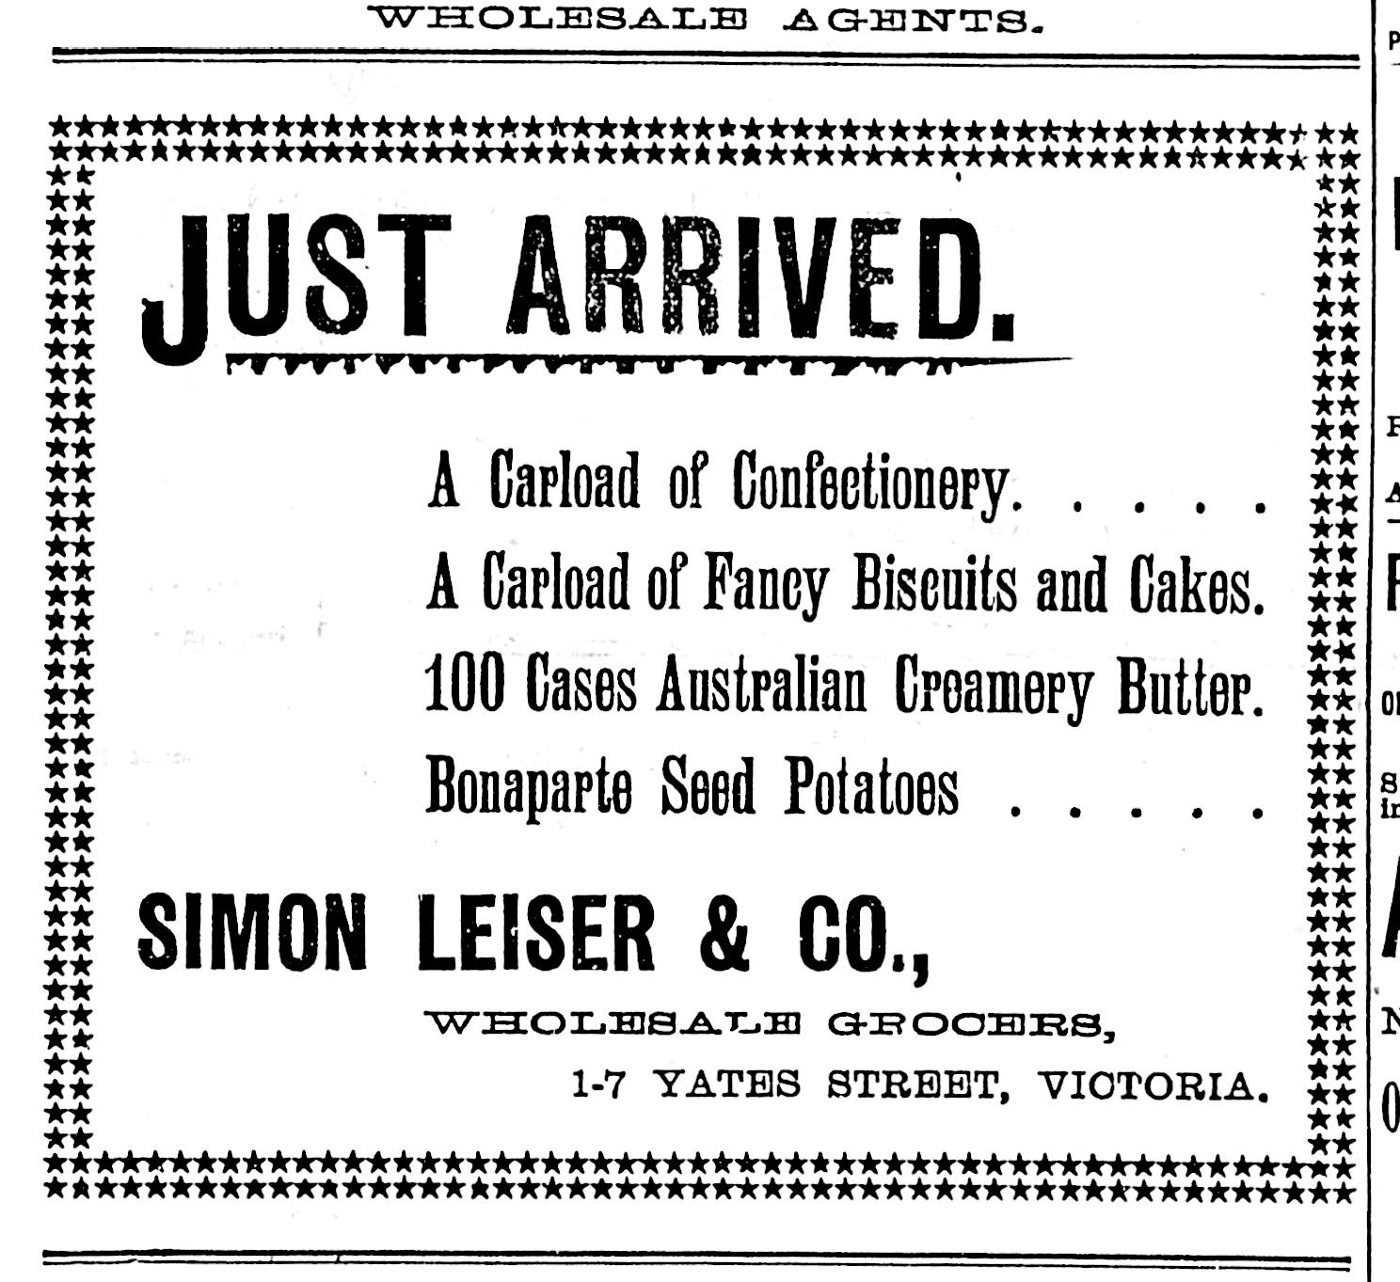
Simon Leiser & Co. advertisement, 1895

Slide 28
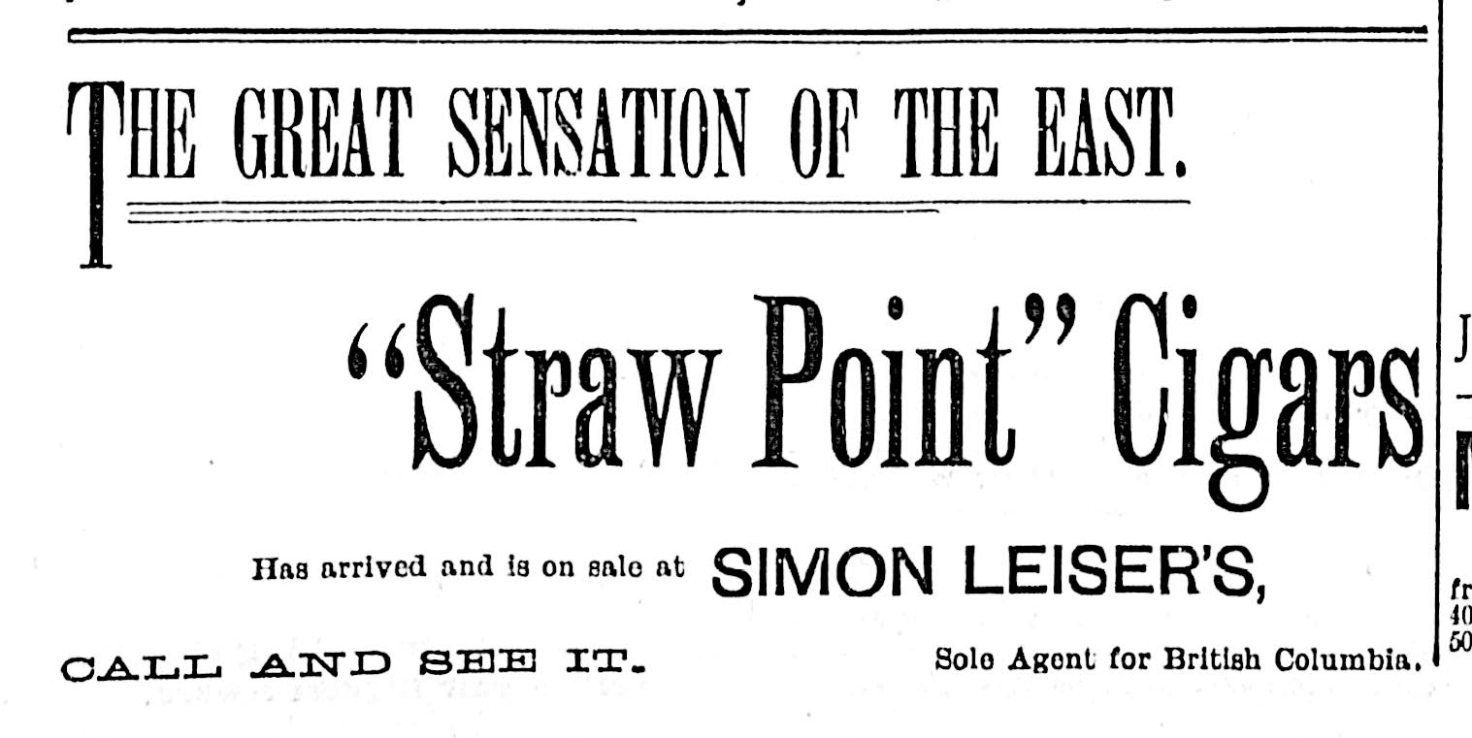
Simon Leiser & Co. advertisement, 1895

Slide 29
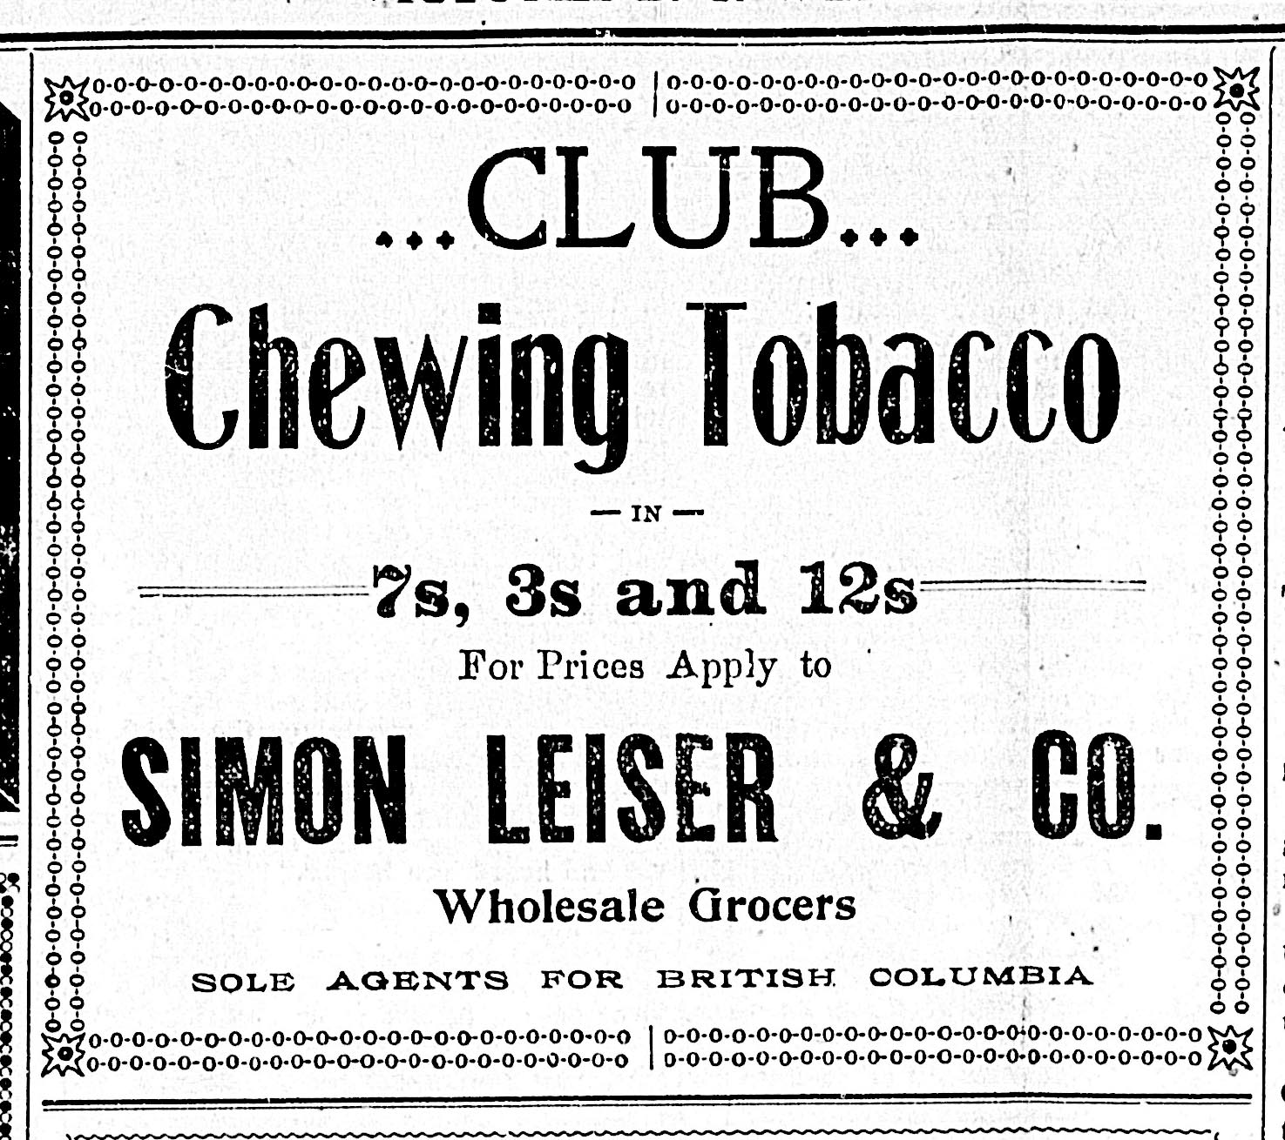
Simon Leiser & Co. advertisement, 1898

Slide 30
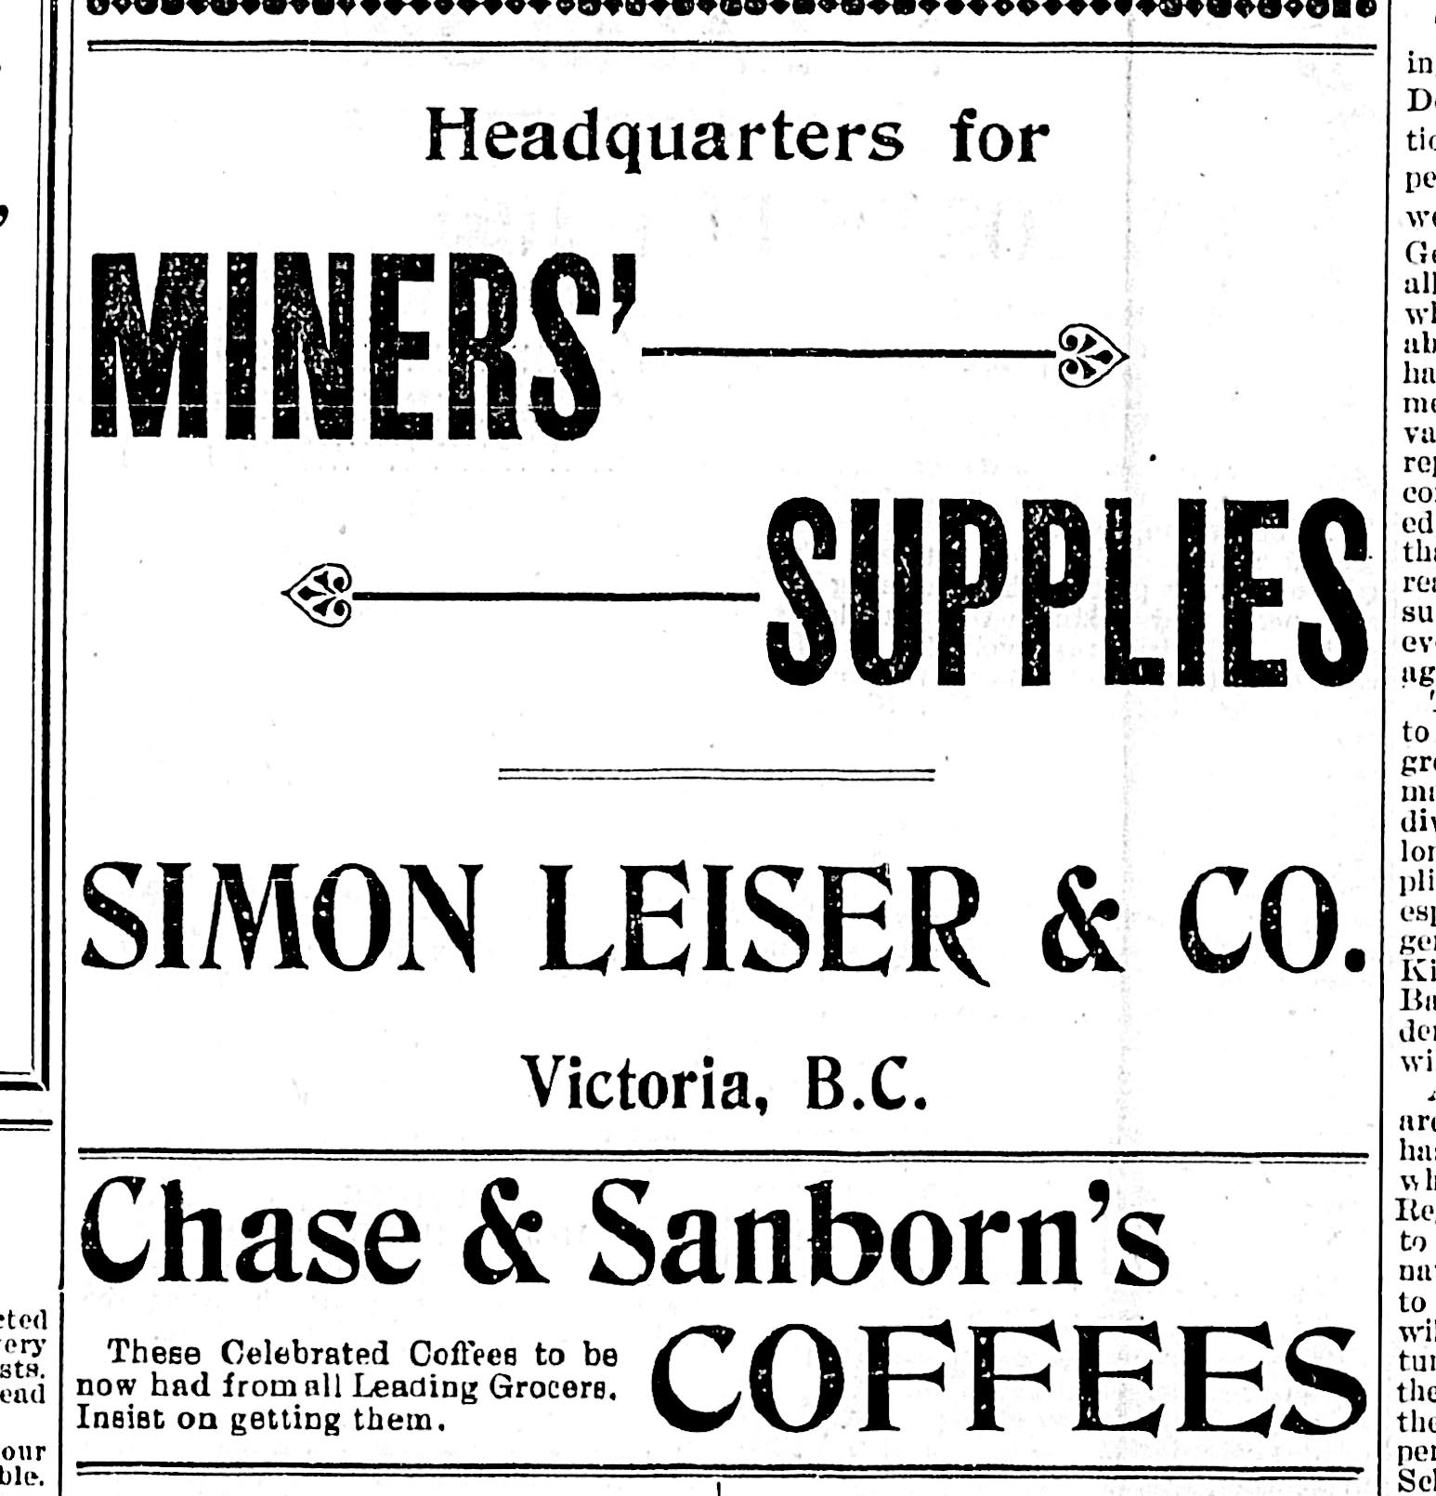
Simon Leiser & Co. advertisement aimed at miners heading to the Klondike gold rush in 1898

Slide 31
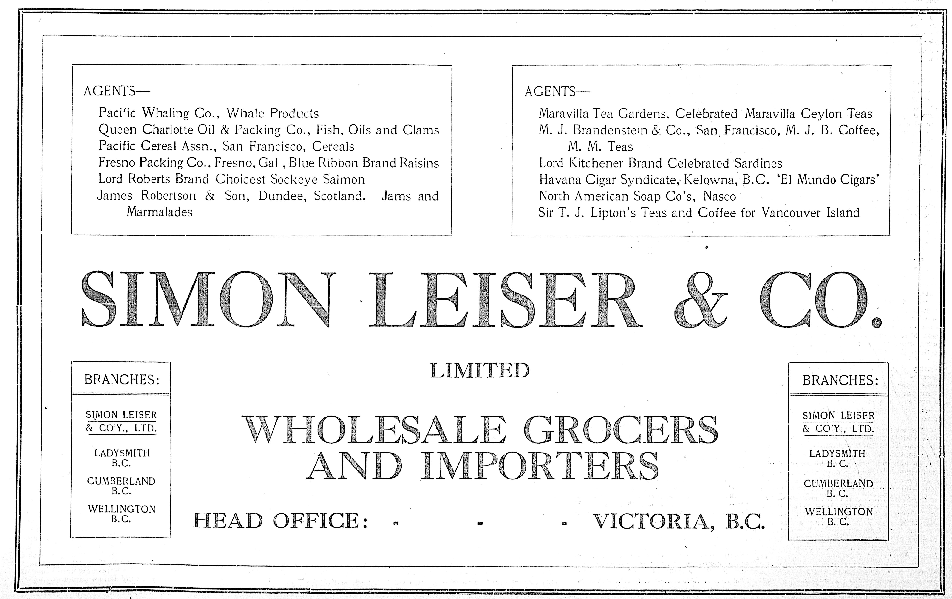
Simon Leiser & Co.
Advertisement, 1908

Slide 32
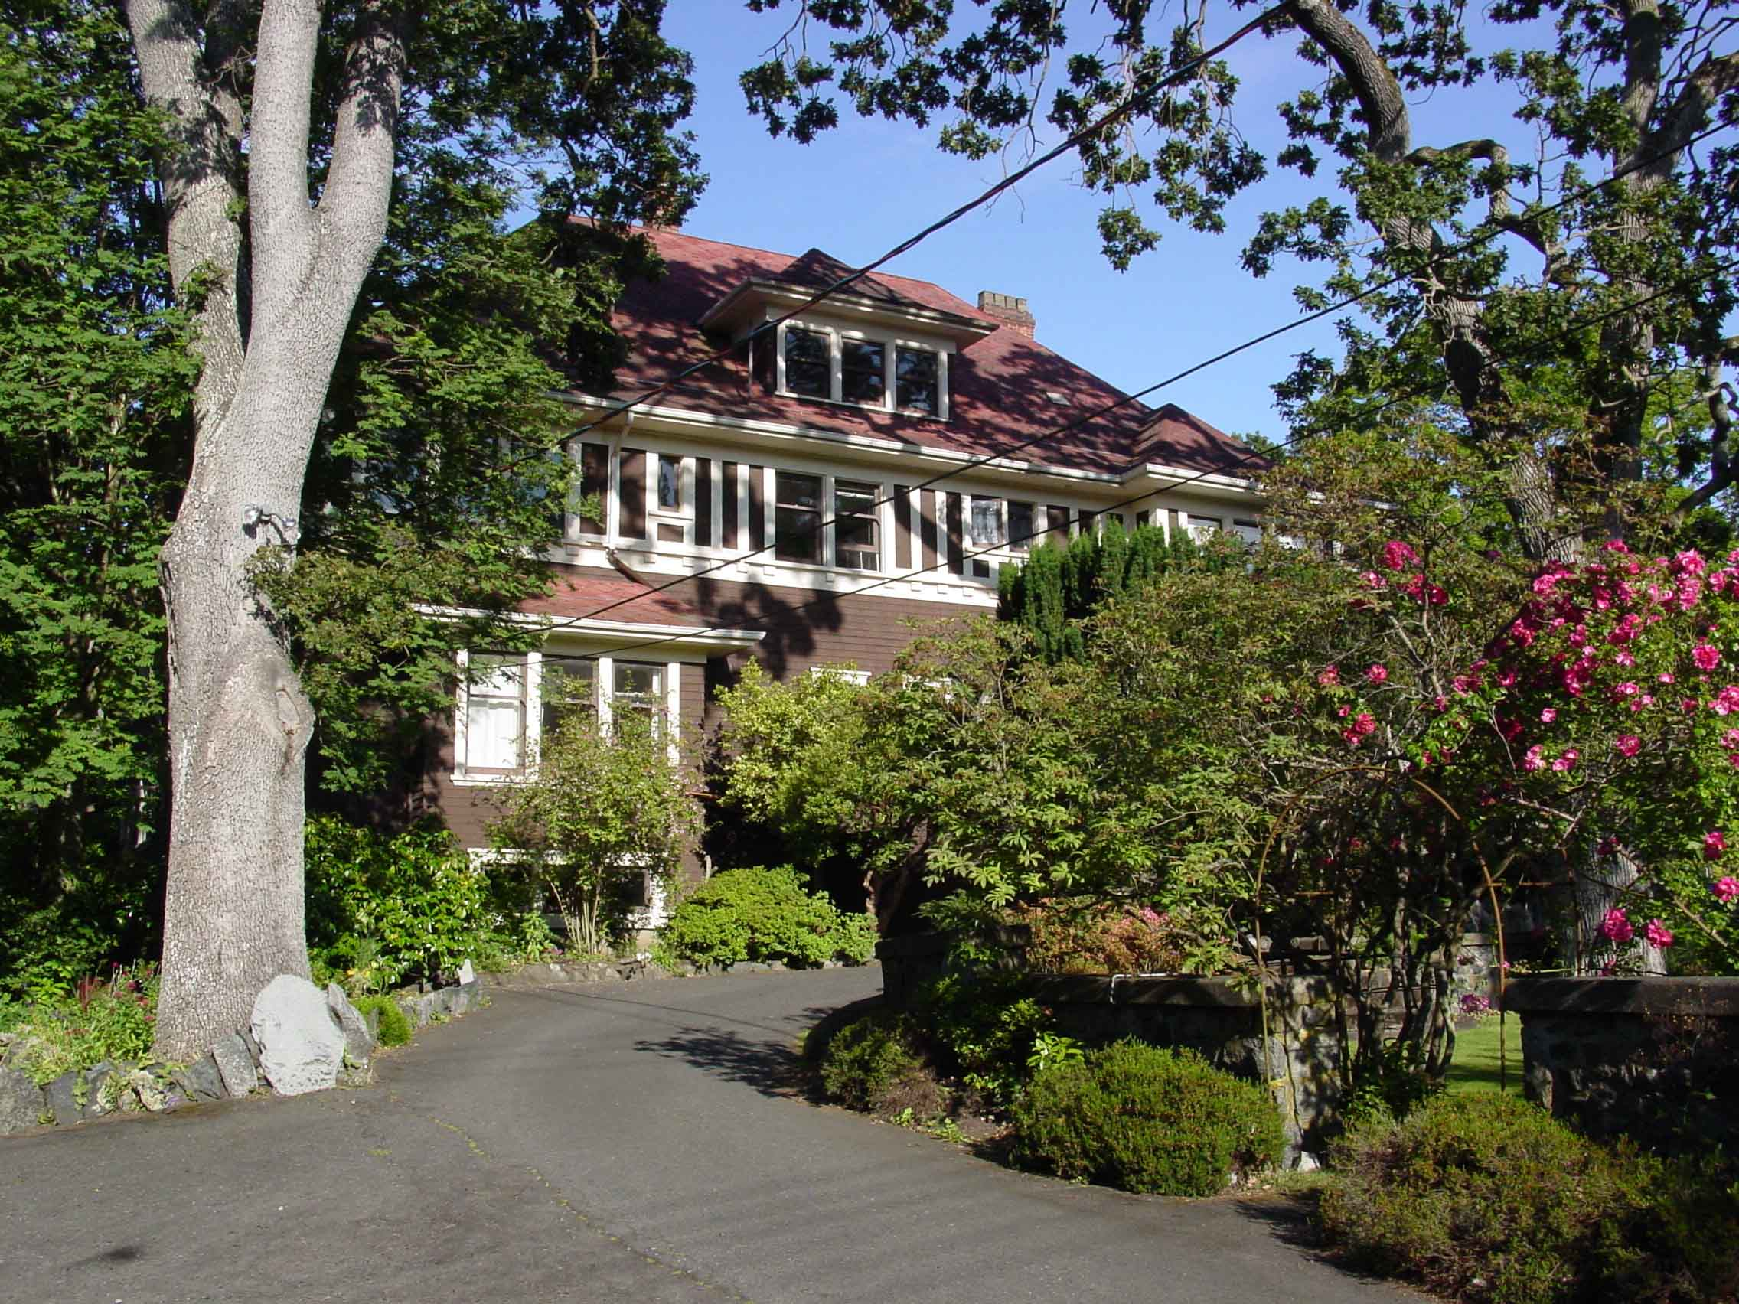
Simon Leiser’s house, 1005 St. Charles St., Victoria.
Designed for Simon Leiser by Victoria architect Samuel Maclure in 1905.
The house is now divided into apartments.

Slide 33
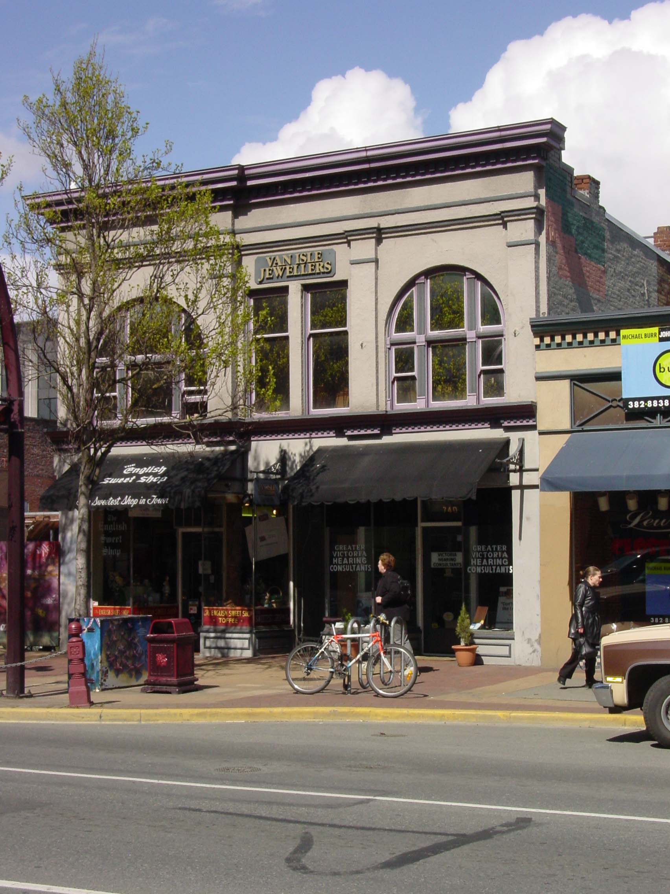
Simon Leiser
(1851-1917)
Hanna’s Undertaking Parlour in the 700 block of Yates Street in 2005.
-Built by William J. Hanna in 1905 for his undertakers business.
William Hanna was a Freemason, a member of Victoria-Columbia Lodge, No.1 in Victoria.
- The building was later purchased by Simon Leiser, who rented it out to other businesses as commercial and office space.

Slide 34
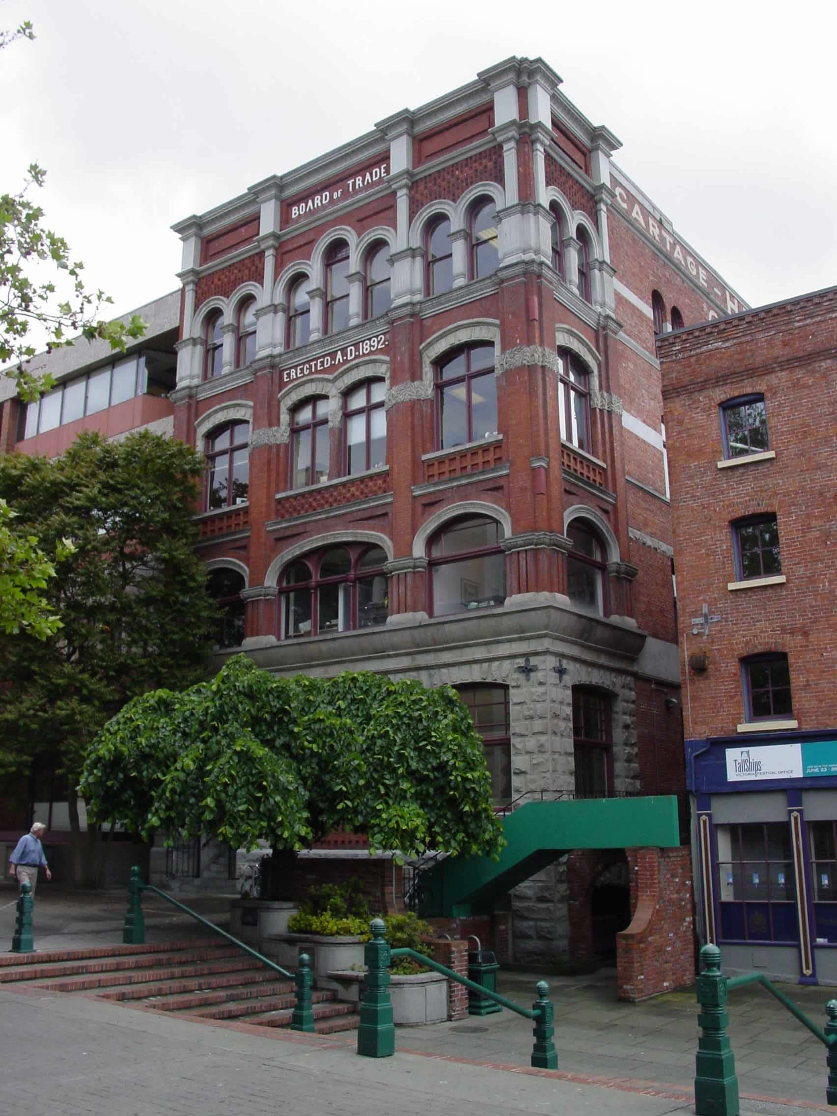
Simon Leiser
(1851-1917)
Simon Leiser was a prominent member of Victoria’s Board of Trade, serving on its Council for 15 years,
Served as Board of Trade Vice President in 1907 and President in 1908 and 1909.
The Board of Trade Building in Bastion Square was built in 1892, designed by a Freemason, Alexander Maxwell Muir, of Vancouver & Quadra Lodge, No. 2. and financed through shares purchased by members, including Simon Leiser and his brother Gustav.
Simon’s brother, Gustav Leiser, was also a prominent member of the Board of Trade, serving as Vice President in 1896.

Slide 35
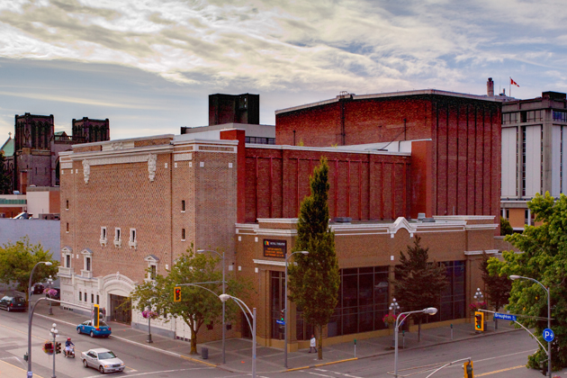
- Royal Theatre -
Simon Leiser was one of the leading members of the company formed to build this theatre in 1913.

Slide 36
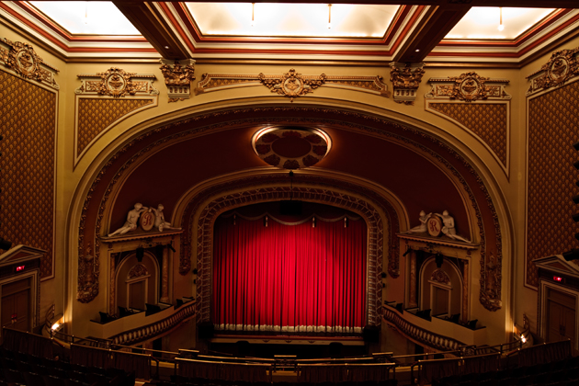
Simon Leiser gave the keynote address on opening night for the Royal Theatre on 29 December 1913. The first performance at the theatre was the play “Kismet.”

Slide 37
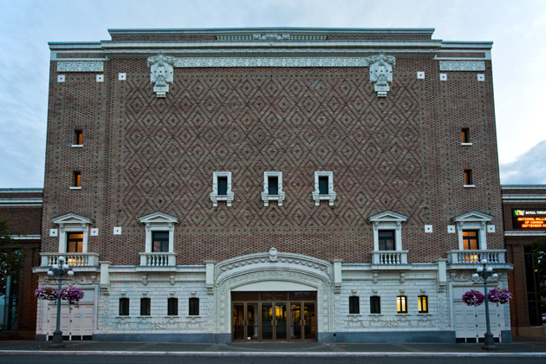
Royal Theatre
A bust of Simon Leiser originally stood in the lobby entrance. It seems to have disappeared in the early 1970s. It might be a worthwhile project to replace it.
Notes:
It might be a worthwhile project to replace the lost bust of Simon Leiser in the Royal Theatre lobby. See if there’s any interest in a collaborative project between Victoria Freemasons (Vancouver & Quadra Lodge #2 might be an obvious leader in such a project since Simon Leiser was a member of V&Q for decades) and Temple Beth Emanu-el.

Slide 38
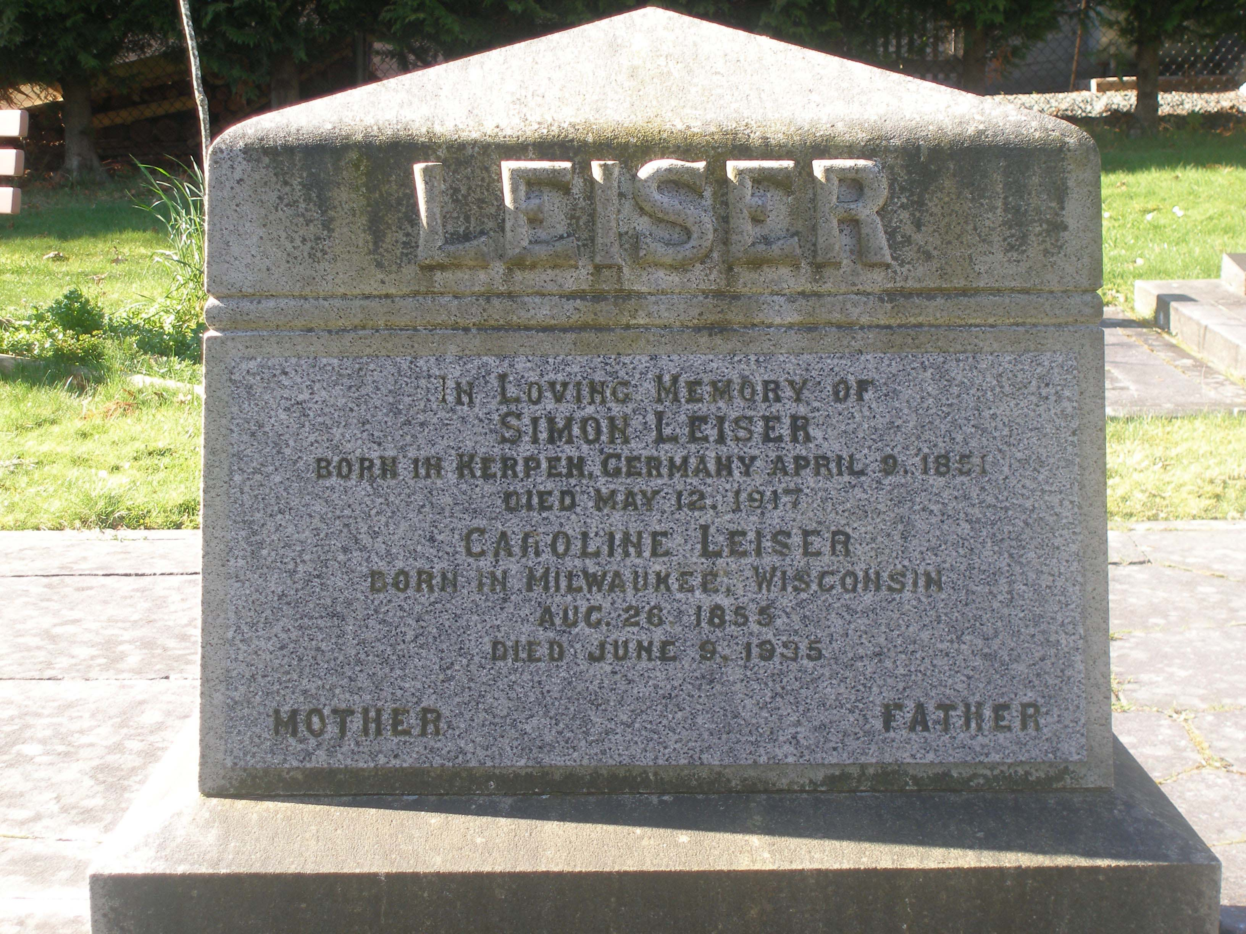
Simon Leiser grave stone in Victoria Jewish Cemetery

Slide 39
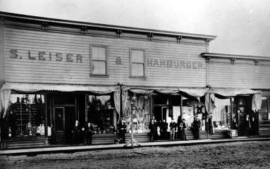
Moses Hamburger
Simon Leiser’s business partner in Ladysmith, B.C.
Notes:
This photo is from the Jewish Museum and Archives of BC, which lists it as being taken in Nanaimo. I think they’re wrong about that; I think it was in Ladysmith (or Wellington, as it was originally known at the time). The notice in slide 40 shows that Moses Hamburger was running Simon Leiser’s business in Wellington in partnership with Simon Leiser. Hamburger was Simon Leiser’s son in law. Moses hamburger was also a member of St. John’s Lodge #21 in Wellington, so all evidence suggests he and his business operations were in Wellington/Ladysmith, not in Nanaimo. Contact Jewish Museum and Archives of BC and tell them about this so they can correct their info.

Slide 40
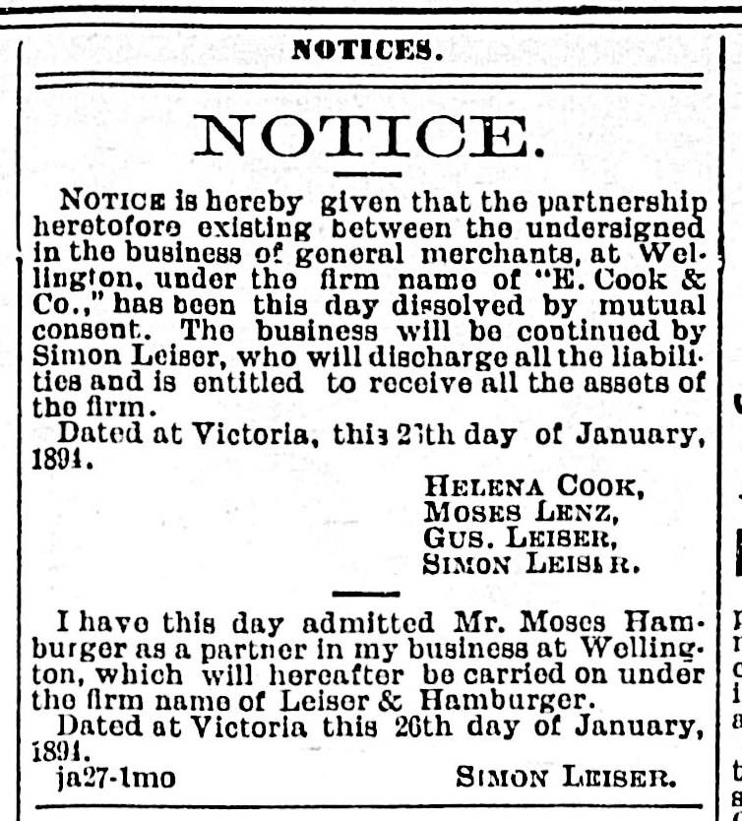
Moses Hamburger & Simon Leiser
Business Partnership in Wellington (now Ladysmith), 1894

Slide 41
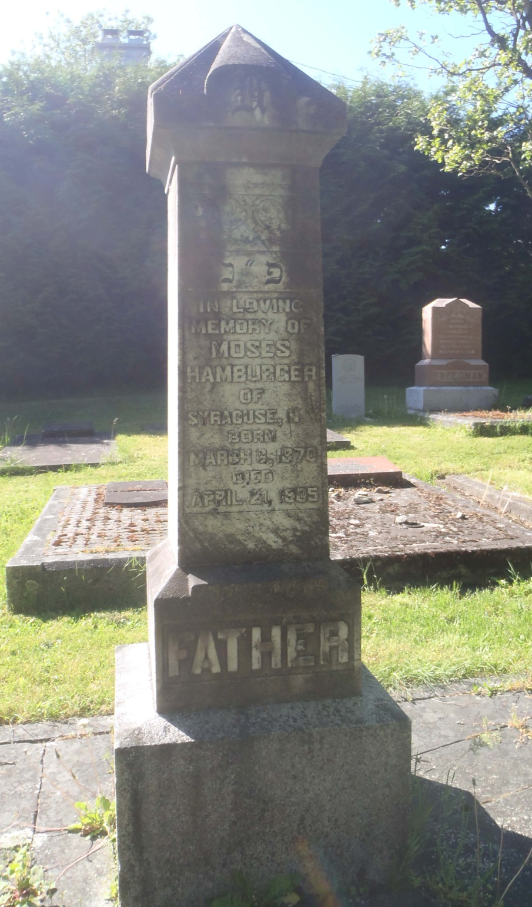
Moses Hamburger
1870- 21 April 1905
Native of Syracuse, N.Y.
Member of St. John’s Lodge, No. 21 in Ladysmith.
Was Simon Leiser’s son in law.
Ran Simon Leiser’s business operations in Wellington, now Ladysmith, in partnership with Simon Leiser beginning in 1894.
At right is Moses Hamburger’s tombstone in Victoria Jewish Cemetery.

Slide 42
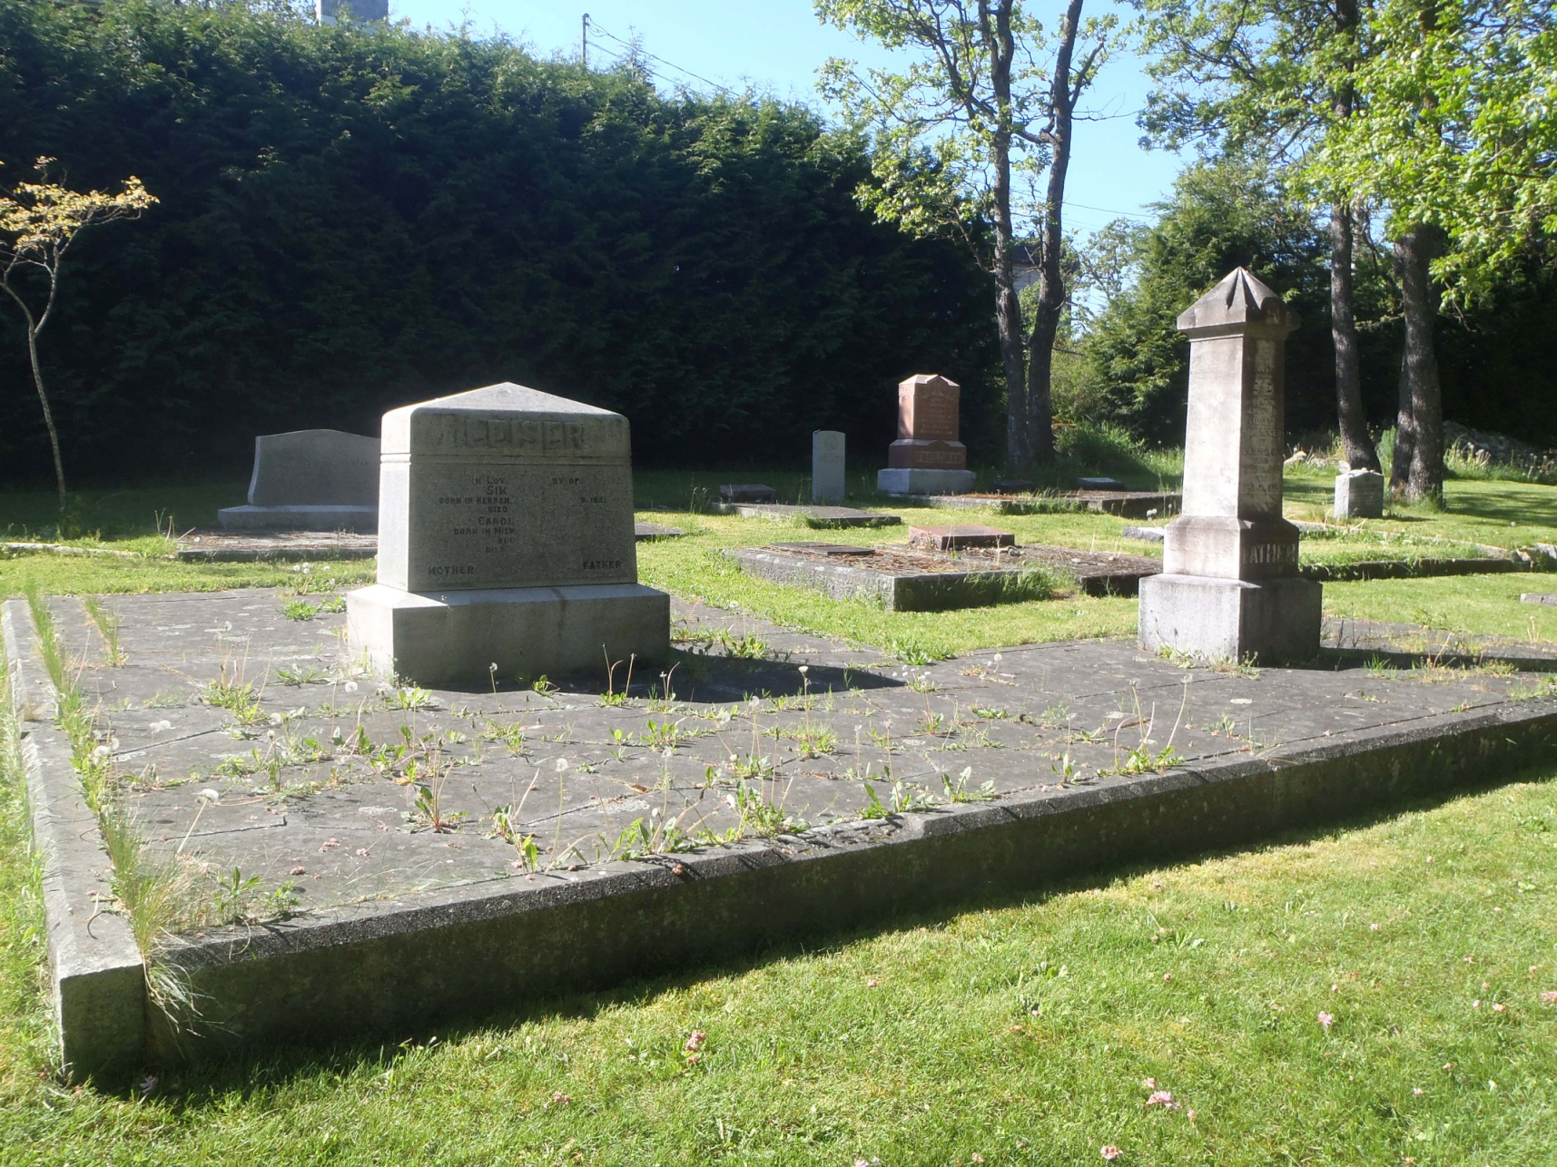
Leiser and Hamburger family grave, Victoria Jewish Cemetery

Slide 43
Gustav Leiser
(1856-1896)
Brother of Simon Leiser.
Applied for Affiliation with Vancouver & Quadra Lodge, No. 2 on 17 November 1886.
At the time of his Affiliation application, he was a member of Union Lodge, No. 9 in New Westminster.
His Application for Affiliation with Vancouver & Quadra Lodge, No. 2 was approved on 15 December 1886.
Vice President of the Board of Trade, 1896
Principal of the firm Lenz & Leiser, a Victoria based dry goods wholesaler

Slide 44
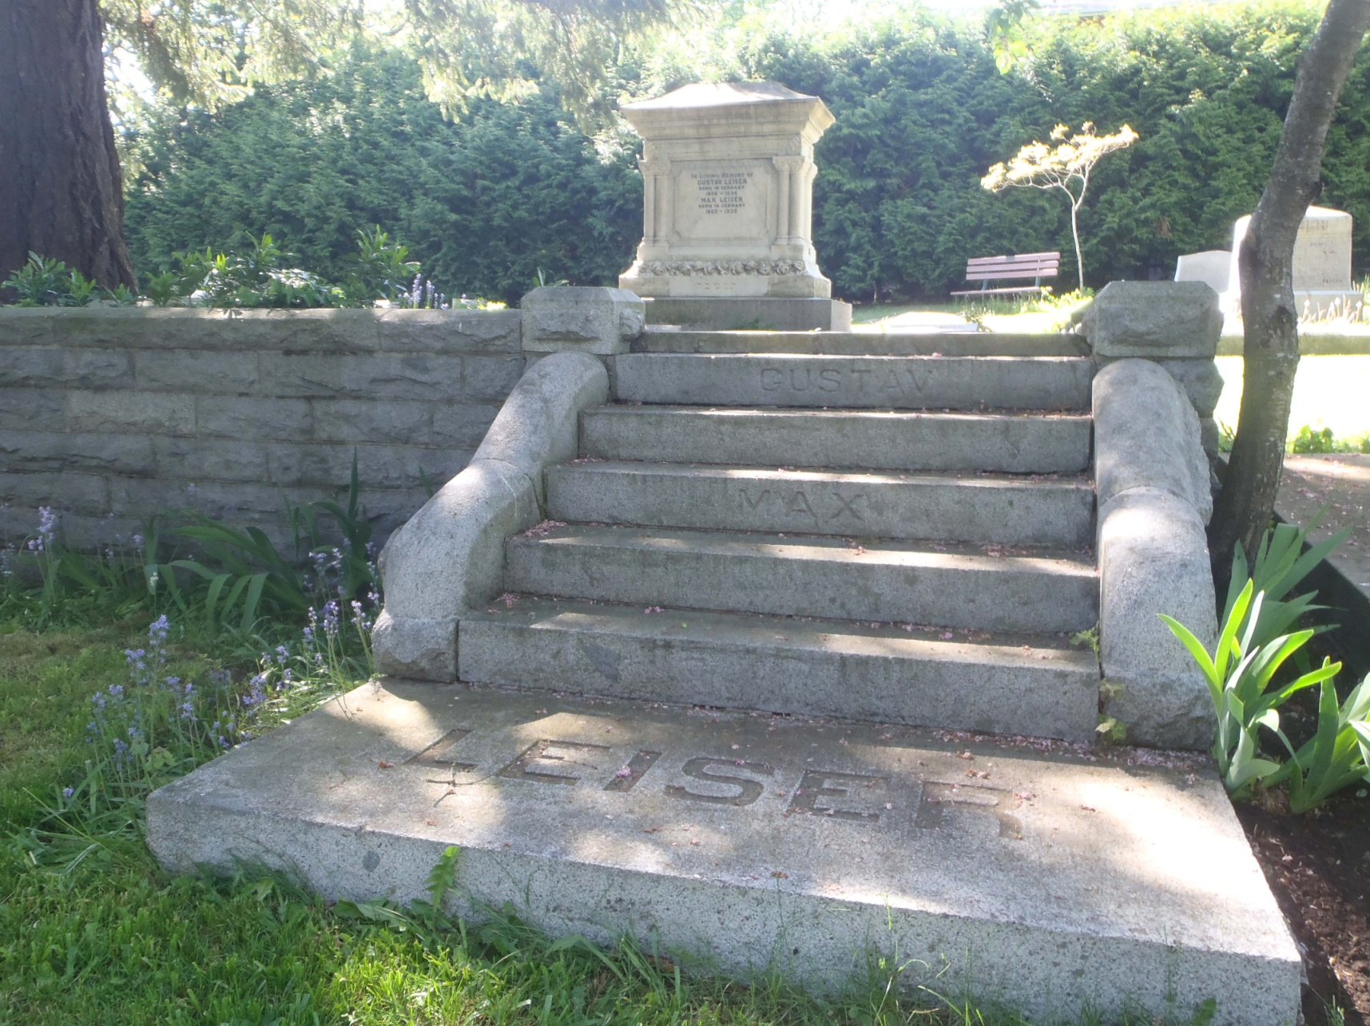
Gustav and Max Leiser tomb
Victoria Jewish Cemetery

Slide 45
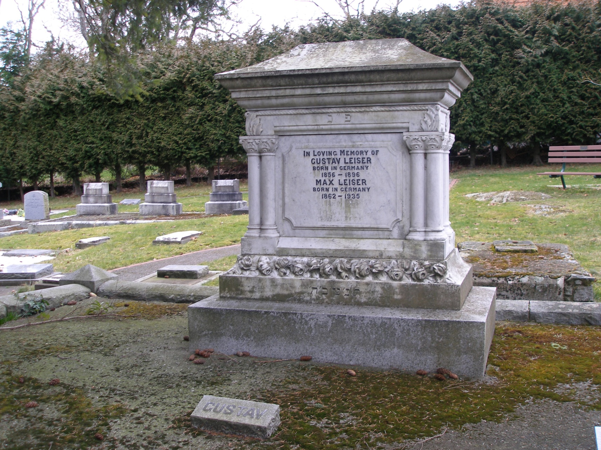
Gustav Leiser
Grave Marker, Victoria Jewish Cemetery

Slide 46
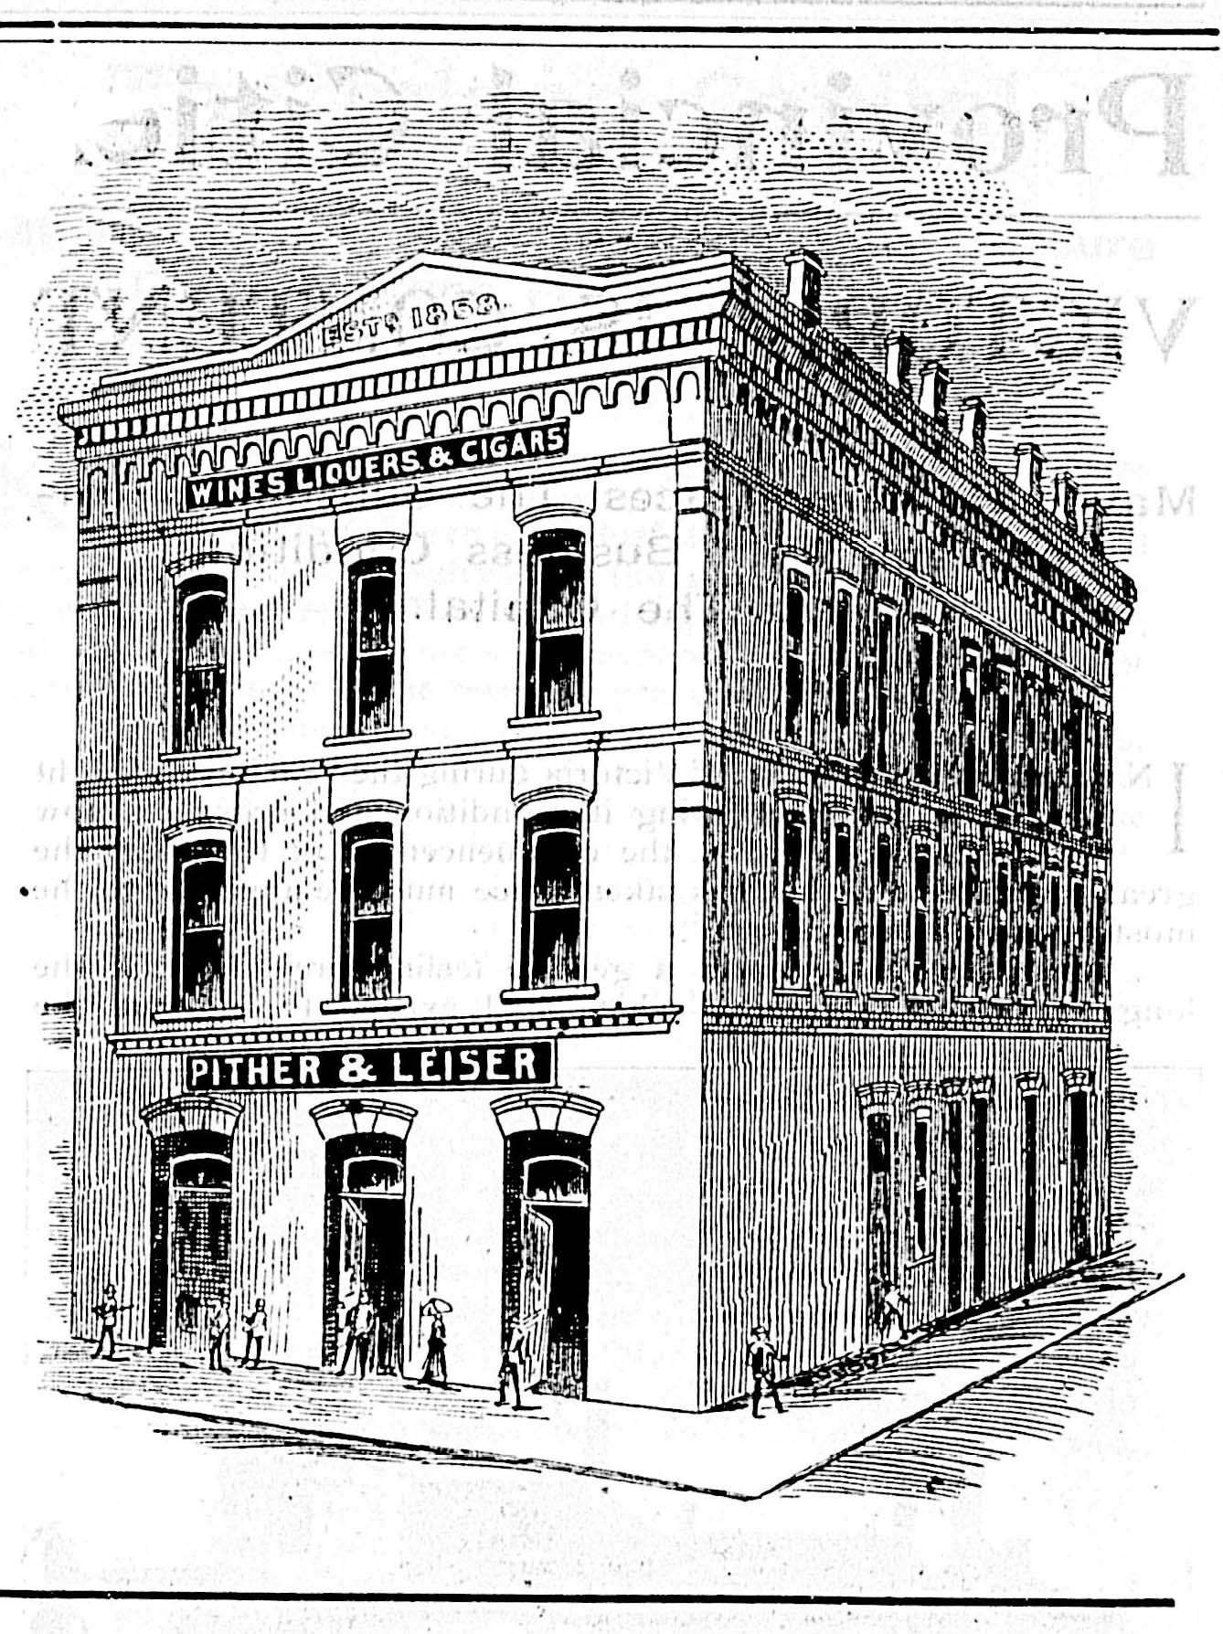
Max Leiser
( 1862-1935 )
- Brother of Simon Leiser
Member of Vancouver & Quadra Lodge, No. 2
Came to Victoria about 1885. Worked for his brother Simon for about a year before going into partnership with Luke Pither as Pither and Leiser, wholesale liquor distributors.

Slide 47
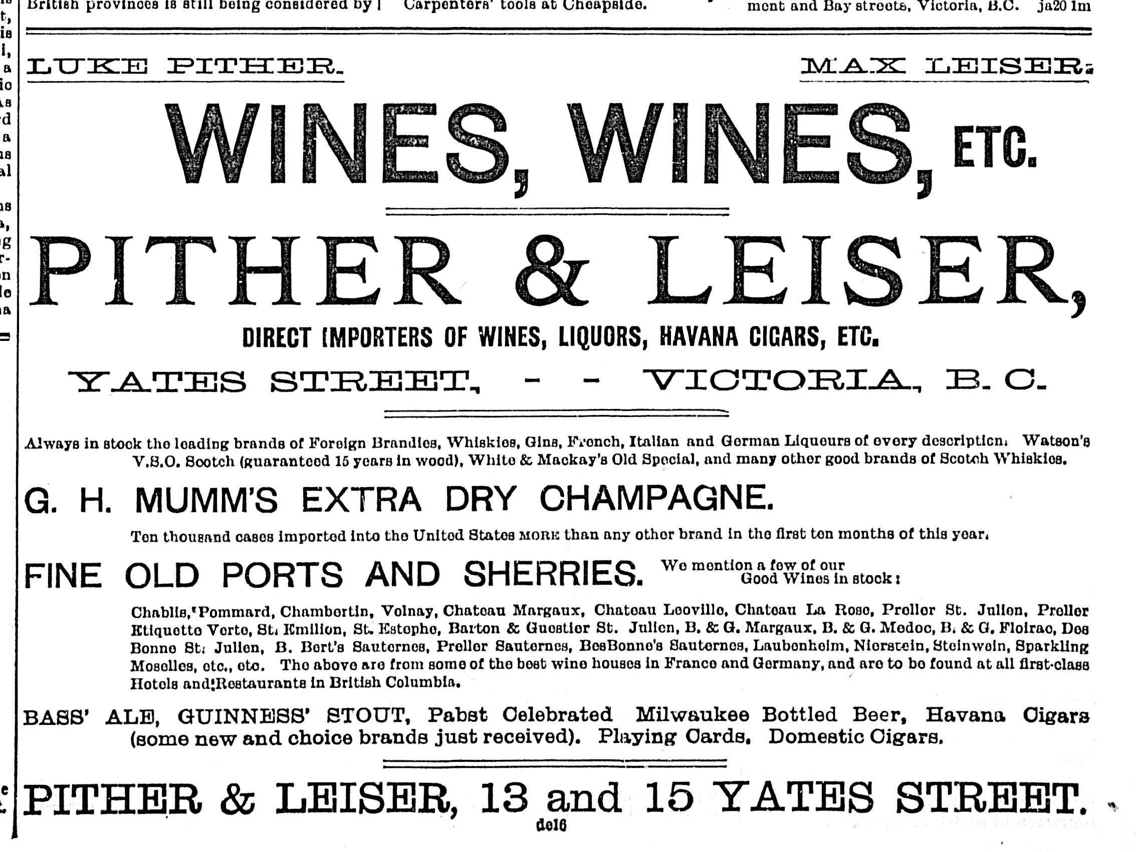
Pither & Leiser advertisement, 1895

Slide 48
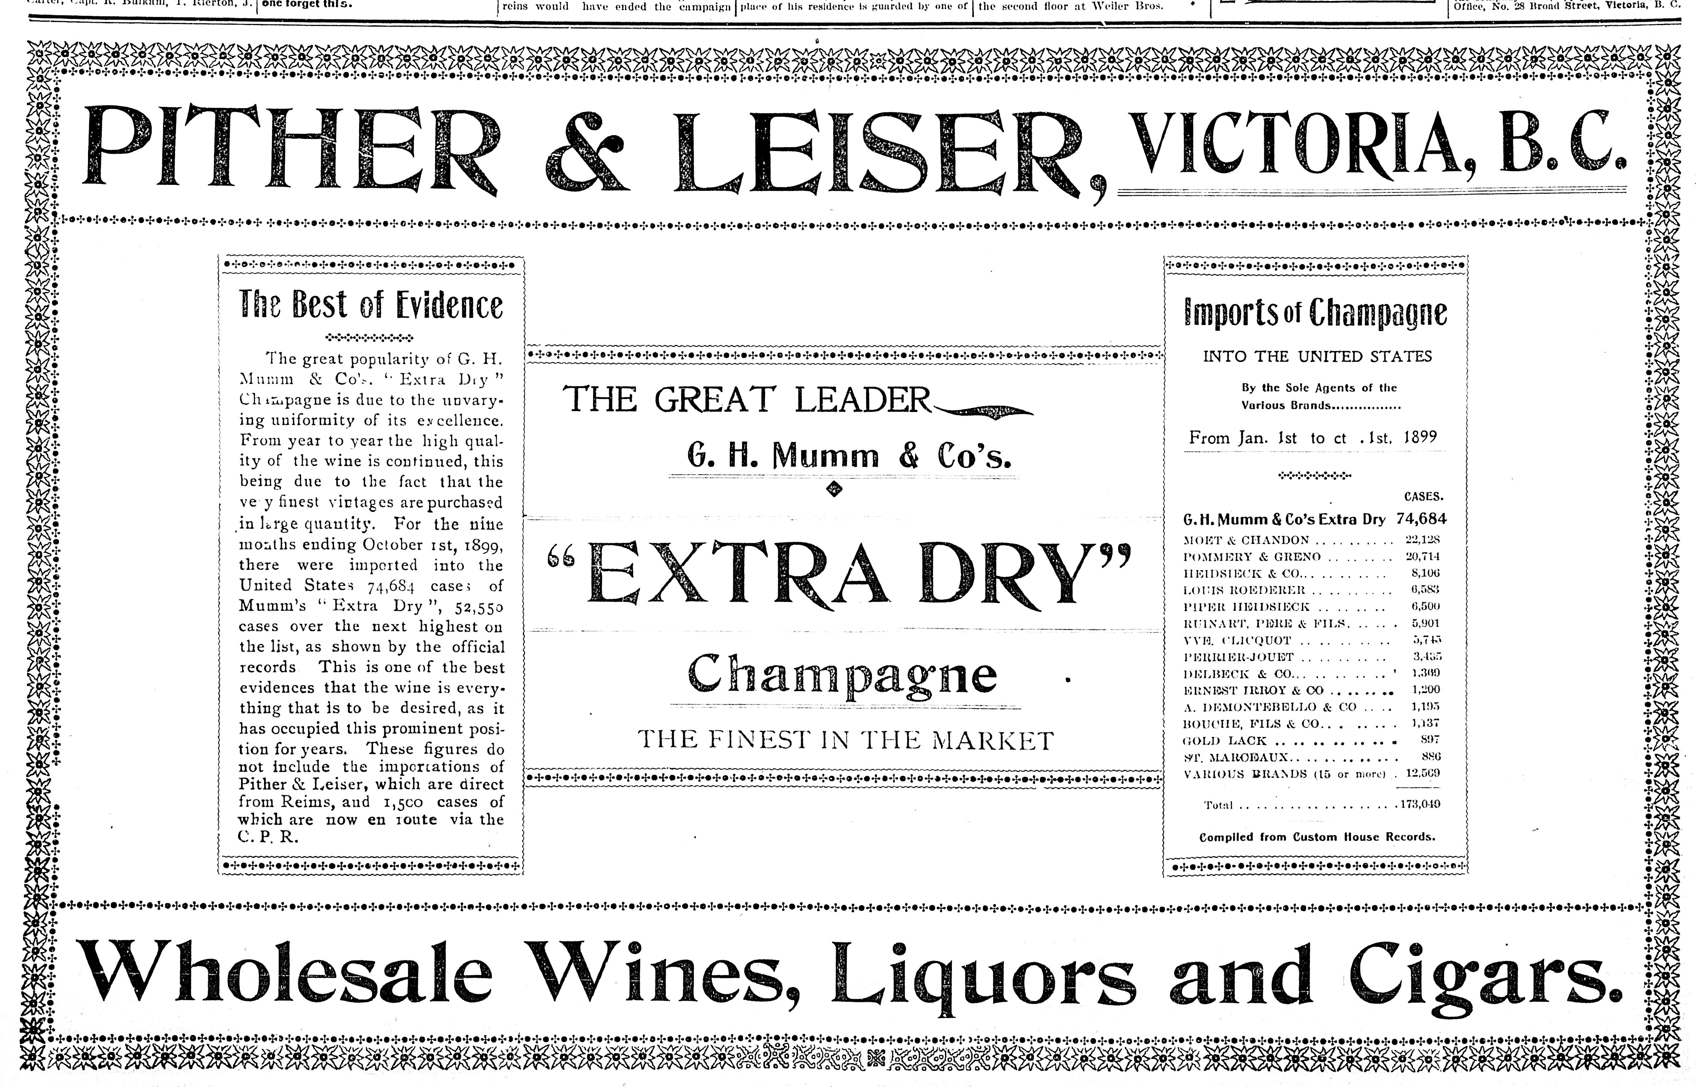
Pither & Leiser advertisement, 1899

Slide 49
Pither & Leiser
Pither & Leiser have left a significant architectural heritage to the City of Victoria.
- Three Pither & Leiser business premises are Victoria heritage Buildings.
This building at 533 Yates Street is the first Pither & Leiser building,.
This image from 1898 shows a three storey building. The current building is only a two storey structure.
If this is the original appearance of the building we’re not sure why the third storey was removed.

Slide 50
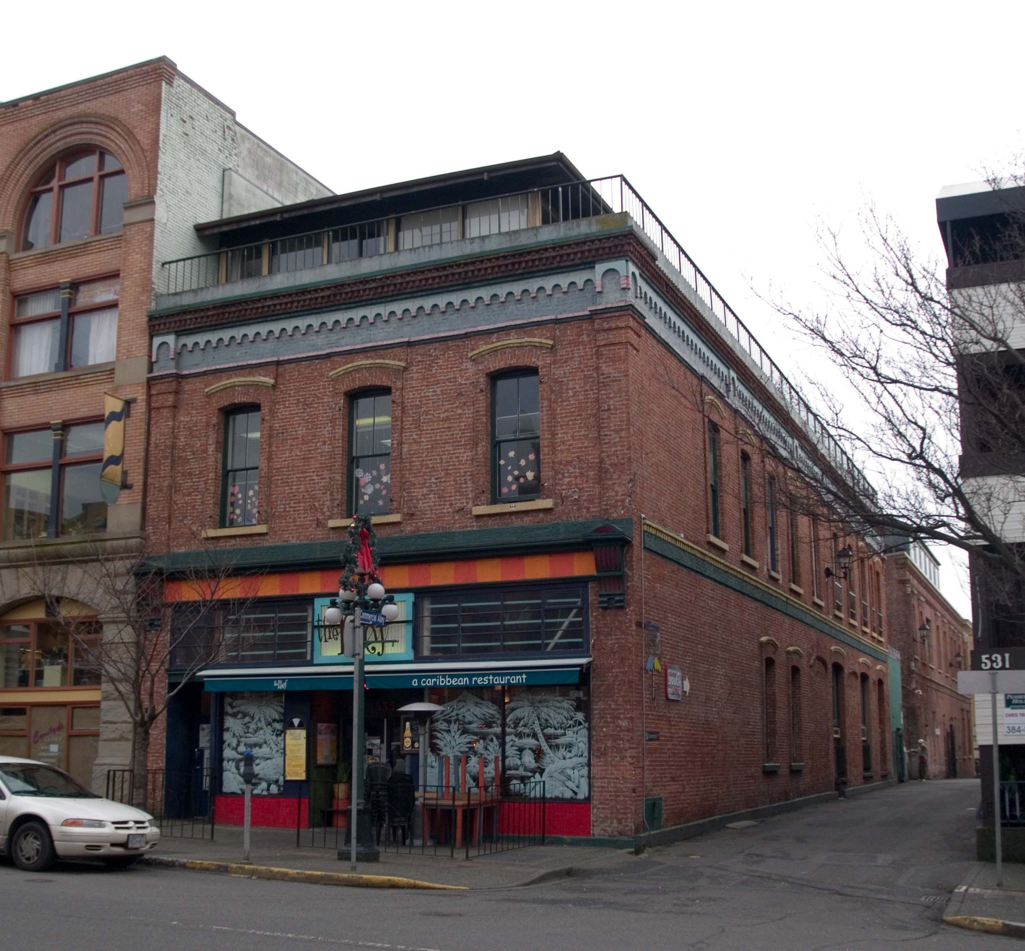
Max Leiser
Pither & Leiser have left a significant architectural heritage to the City of Victoria.
- Three Pither & Leiser business premises are Victoria heritage Buildings.
This building at 533 Yates Street is the first Pither & Leiser building,.
Note that the third storey has been removed.

Slide 51
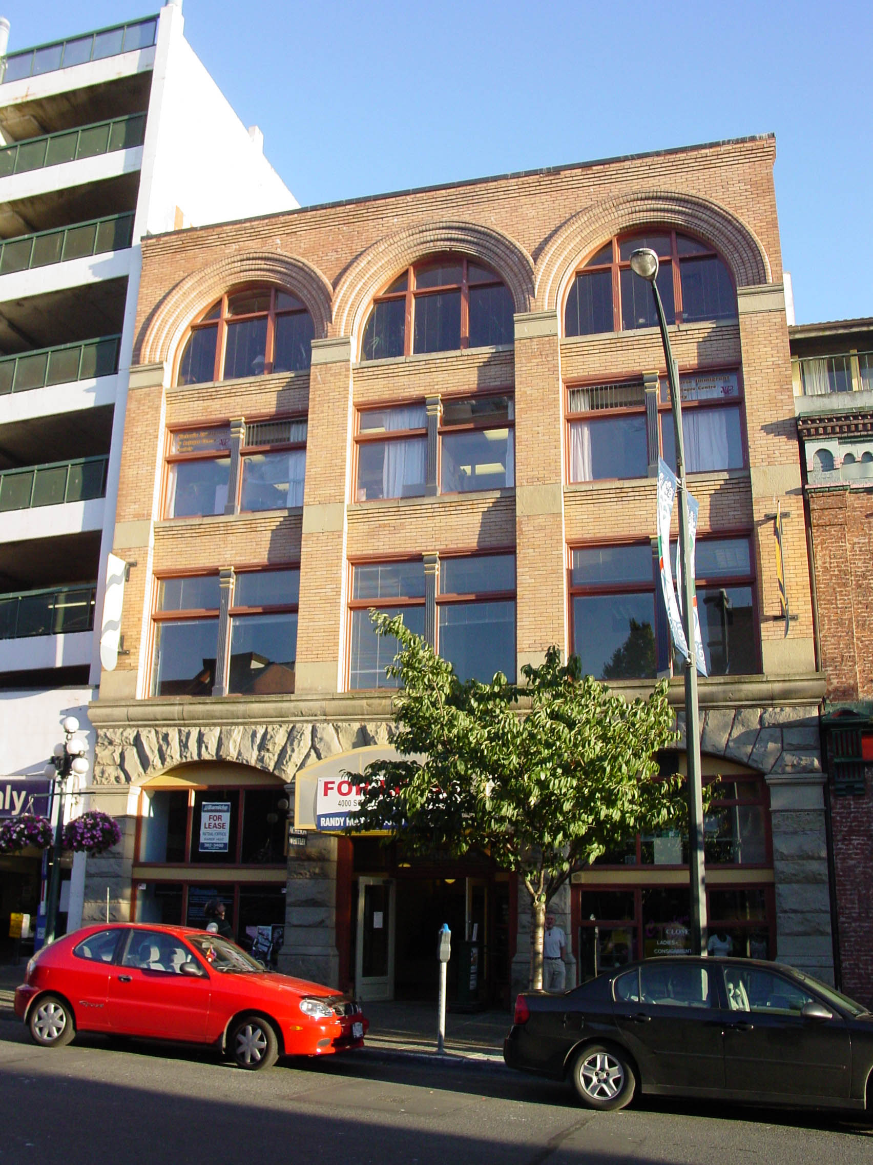
Pither & Leiser
Max Leiser
Pither & Leiser have left a significant architectural heritage to the City of Victoria.
- Three Pither & Leiser business premises are Victoria heritage Buildings.
This building at 535 Yates Street is the second Pither & Leiser building,.
- Designed for the firm by architect Thomas Hooper and built in 1900 by contractor John Hepburn at an estimated cost of $14,000.
- It was built as warehouse and office space. Pither & Leiser used it as its Victoria headquarters until 1905.

Slide 52
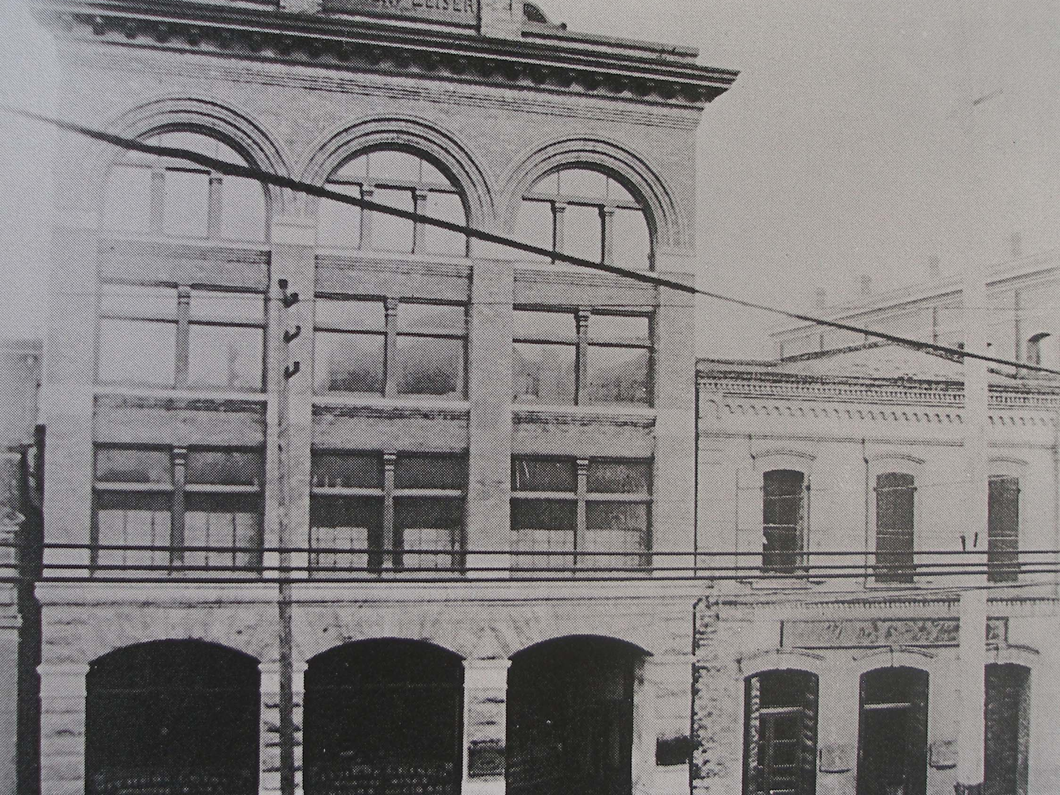
The first two Pither & Leiser buildings on Yates Street, circa 1900

Slide 53
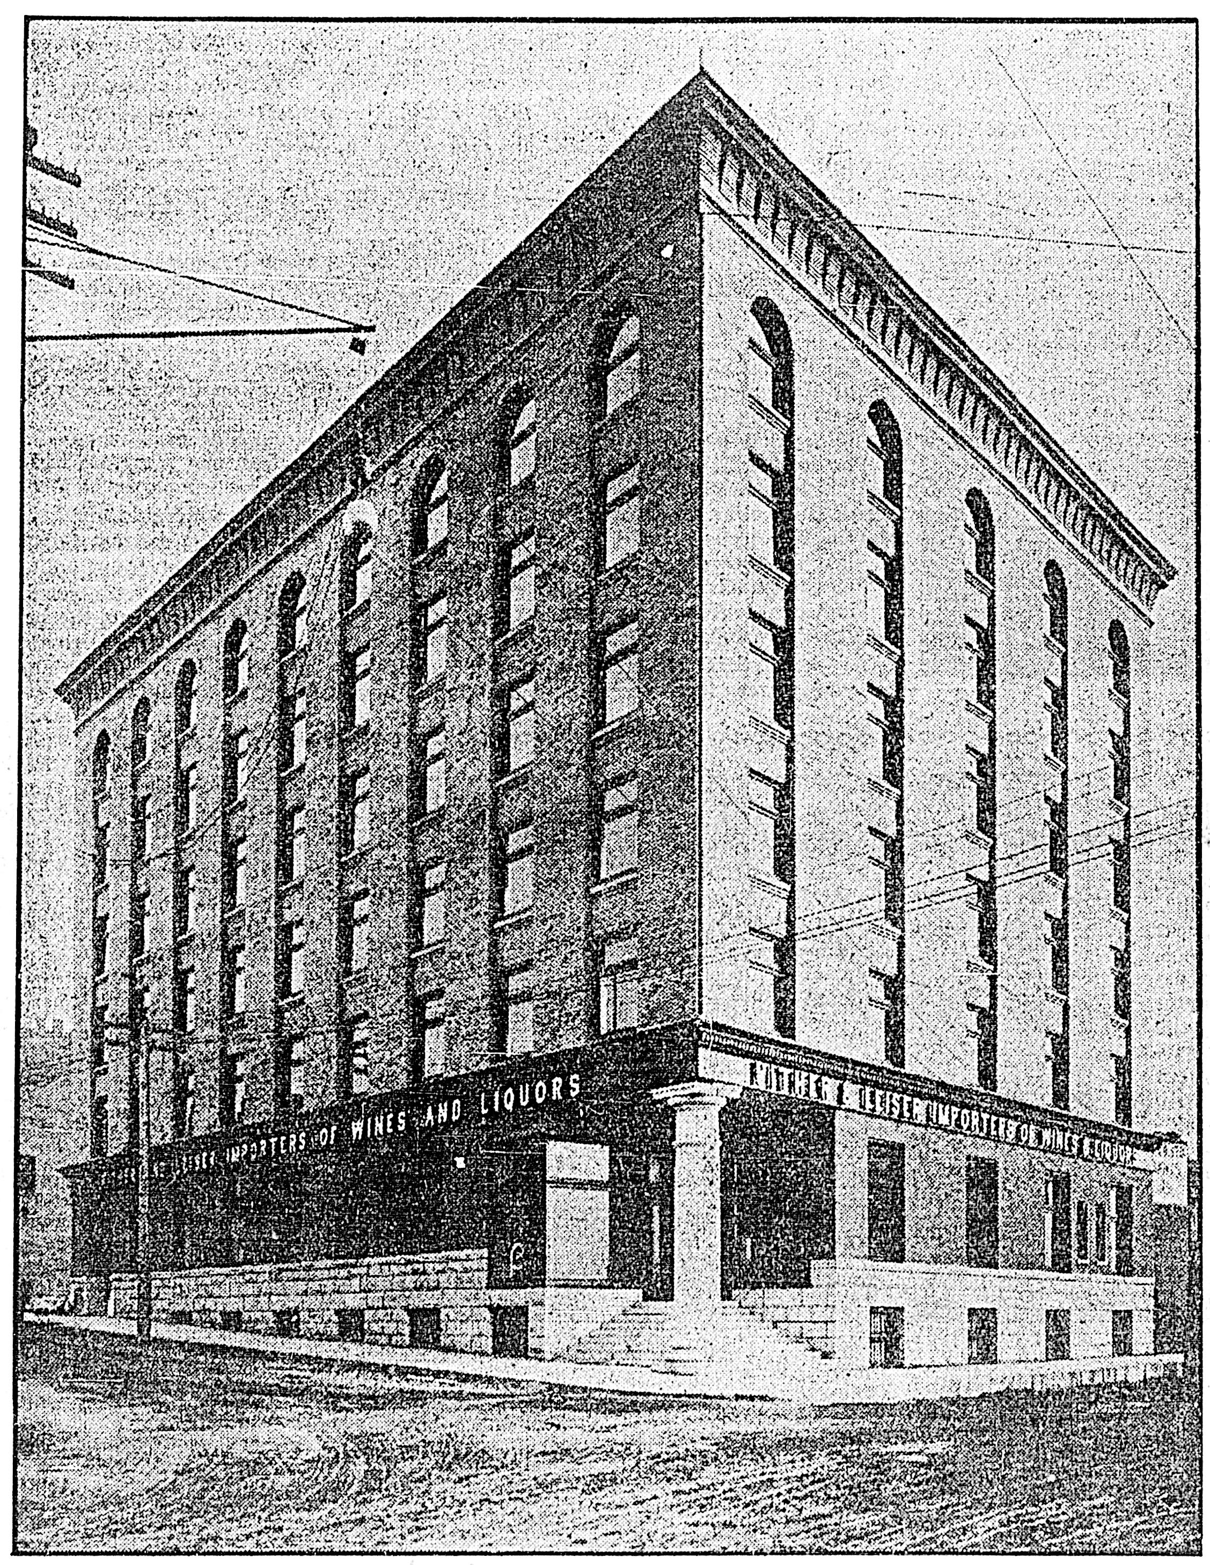
Pither & Leiser
Max Leiser
Pither & Leiser have left a significant architectural heritage to the City of Victoria.
- Three Pither & Leiser business premises are Victoria heritage Buildings.
This building at 1019 Wharf Street is the third Pither & Leiser building in Victoria,.
- Designed for the firm by the Victoria architectural firm of Thomas Hooper C. Elwood Watkins and built in 1906.
This photograph was taken circa 1909 before Wharf and Fort Streets were paved.

Slide 54
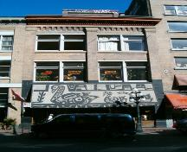
Pither & Leiser
Max Leiser
Pither & Leiser had its corporate headquarters in Victoria but it also had operations in Vancouver.
This building at 165 Water Street in Vancouver’s Gastown district was built by Pither & Leiser in 1905 as its Vancouver warehouse and office.
It is on the City of Vancouver Heritage Building Register.

Slide 55

Pither & Leiser was purchased in 1910 for over $1 million by the Guinness family of Guinness stout fame. Luke Pither retired to a farm in Saanich. Max Leiser became a real estate investor and developer.

Slide 56

Max Leiser built this building at 899 Fort Street in 1911
-The original plans called for a three storey, 39 room brick building intended for use as stores and offices. The estimated construction cost was $25,000.

Slide 57

Max Leiser
1320 – 1324 Blanshard Street (at Johnson Street}
Designed and built by architect Thomas Hooper for Max Leiser in 1912.
- Original plans called for a four storey, 36 room brick and terra cotta building, intended to be used as a hotel.
- Original estimated cost was $28,000.
- Originally known as the Kaiserhof Hotel, it was damaged and looted during anti-German riot following the sinking of the Lusitania by a German U-boat off the Irish coast in 1915.
- Subsequently known variously as Blanshard Hotel, Cecil Hotel, Kent Apartments.

Slide 58

Lewis Lewis
(1828-1904)
Member of Vancouver & Quadra Lodge, No. 2 in Victoria.
President of Congregation Beth Emanu-el for 8 years.
Member of I.O.O.F., Victoria Lodge, No. 1.
Came to Victoria in 1858. Went into business on Yates Street, first as a clothier, then as a plumber and tinsmith.

Slide 59

Lewis Lewis

Slide 60

Lewis Lewis building during 2008 renovation

Slide 61

Lewis Lewis
This advertisement from 1872 shows Lewis Lewis in the clothing business with retail premises in what is now the 500 block of Yates Street.

Slide 62

Lewis Lewis
This advertisement from 1895 shows Lewis Lewis wanting to retire from his Tinsmith and Plumbing business, which he had operated at 44 Yates Street since about 1885.
He had been in business at that location since arriving in Victoria in 1858.

Slide 63

Lewis Lewis
The Lewis family grave in the Victoria Jewish Cemetery.
The grave contains the remains of : -
- Lewis Lewis,
- his son Philip, who died 23 March 1884, aged 26

Slide 64

Lewis Lewis
The inscription on the tombstone of Lewis Lewis.
The Masonic Square and Compasses at the top of the stone are depicted along with the Independent Order of Odd Fellows three link chain, symbolizing Friendship, Love and Truth.
In 19th and early 20th century Victoria it was quite common for men to hold membership in both the Freemasons and the Odd Fellows.

Slide 65

Marcus Wolfe
Past Grand Master
(died November 1896, aged 51)
Member of Ashlar Lodge, No. 3 in Nanaimo.
Masonic Grand Master June 1891 to June 1892
Although based in Nanaimo, he had business interests in Victoria.
Buried in Victoria Jewish Cemetery, although I haven’t been able to find his grave.

Slide 66

Samuel Davies Schultz
( 1865 -1917)
First Jewish judge appointed to the bench in B.C.
Born in Victoria, the son of Herman and Elizabeth Schultz.
Nephew of Joshua Philip Davies.
Educated at Victoria High School, University of Toronto and Osgoode Hall.
Practiced law in Victoria, Nelson and Vancouver.
Appointed to the bench in 1914.
Notes:
The day after I did this presentation, the Naden Band performed a composition by Samuel Davies Schultz as the parade went from the Masonic Temple to Temple Beth Emanu-el on 2 June 2013.

Slide 67

Isaac and David Oppenheimer
Both Issac Oppenheimer and his brother David were members of Vancouver & Quadra Lodge, No. 2 in Victoria.
David Oppenheimer affiliated with Vancouver & Quadra Lodge, No. 2 on 19 August 1885. He demitted on 19 January 1889.
Lodge records show they were also members of Union Lodge, No. 9 in New Westminster.
Isaac Oppenheimer also appears to have demitted from Vancouver & Quadra, No. 2 on 19 January 1889.
The photo at right is of David Oppenheimer, circa 1890.

Slide 68


Isaac and David Oppenheimer
The Oppenheimer family tomb in the Victoria Jewish Cemetery
David Oppenheimer

Slide 69

Ed Mallek
Member of St. Andrew’s Lodge, No. 49.
Photo at right shows him as Worshipful master of St. Andrew’s Lodge in 1949.
He ran a clothing store called Mallek’s which was a prominent feature of Douglas Street.

Slide 70

The Victoria Jewish Cemetery Cat
Notes:
This friendly neighbourhood cat accompanied me throughout Victoria Jewish Cemetery for about half an hour while I was doing research. If she was a feral cat I would have adopted her on the spot.

